Slide 1

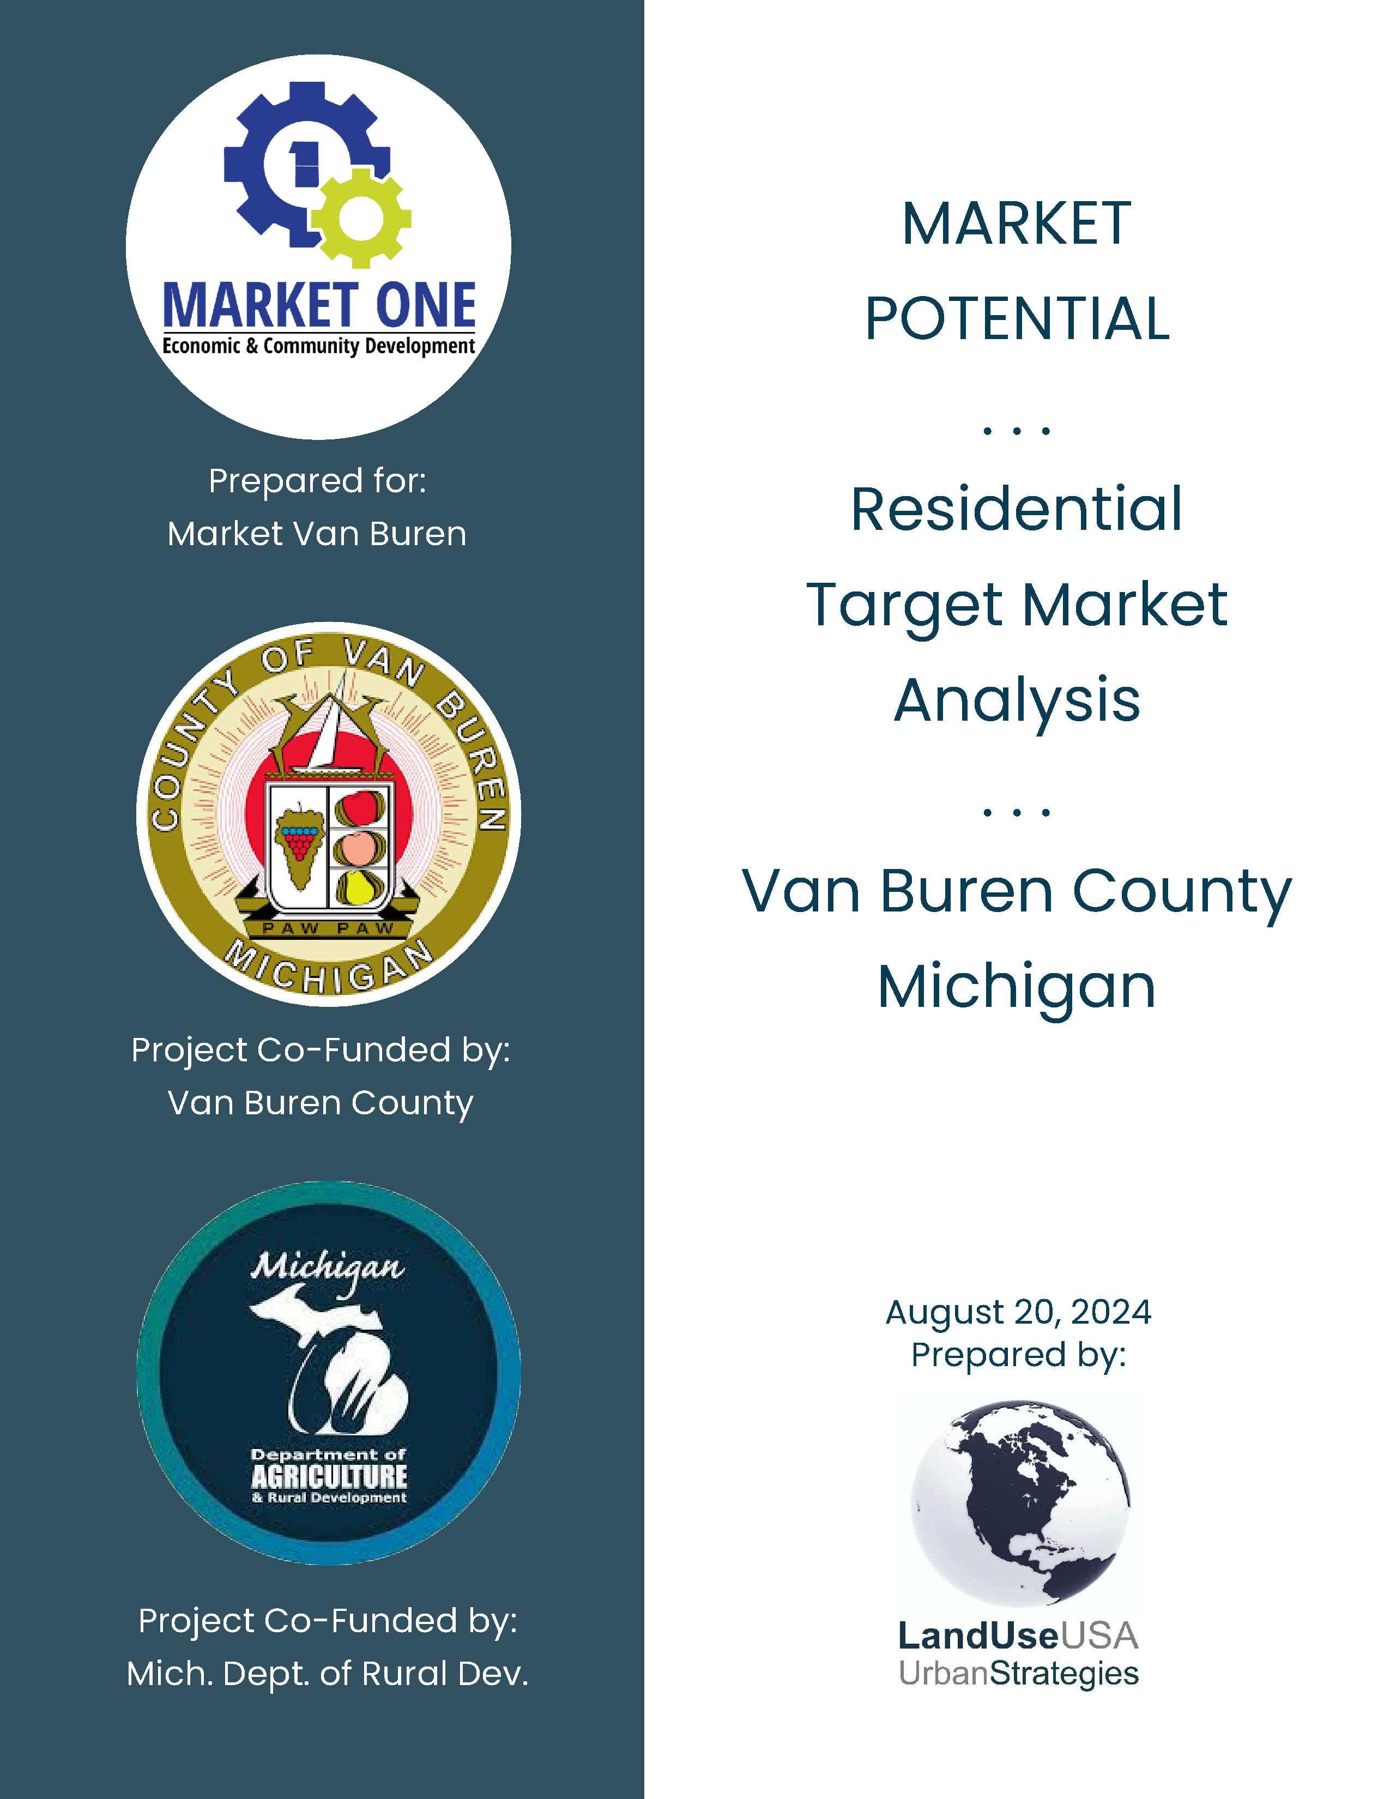
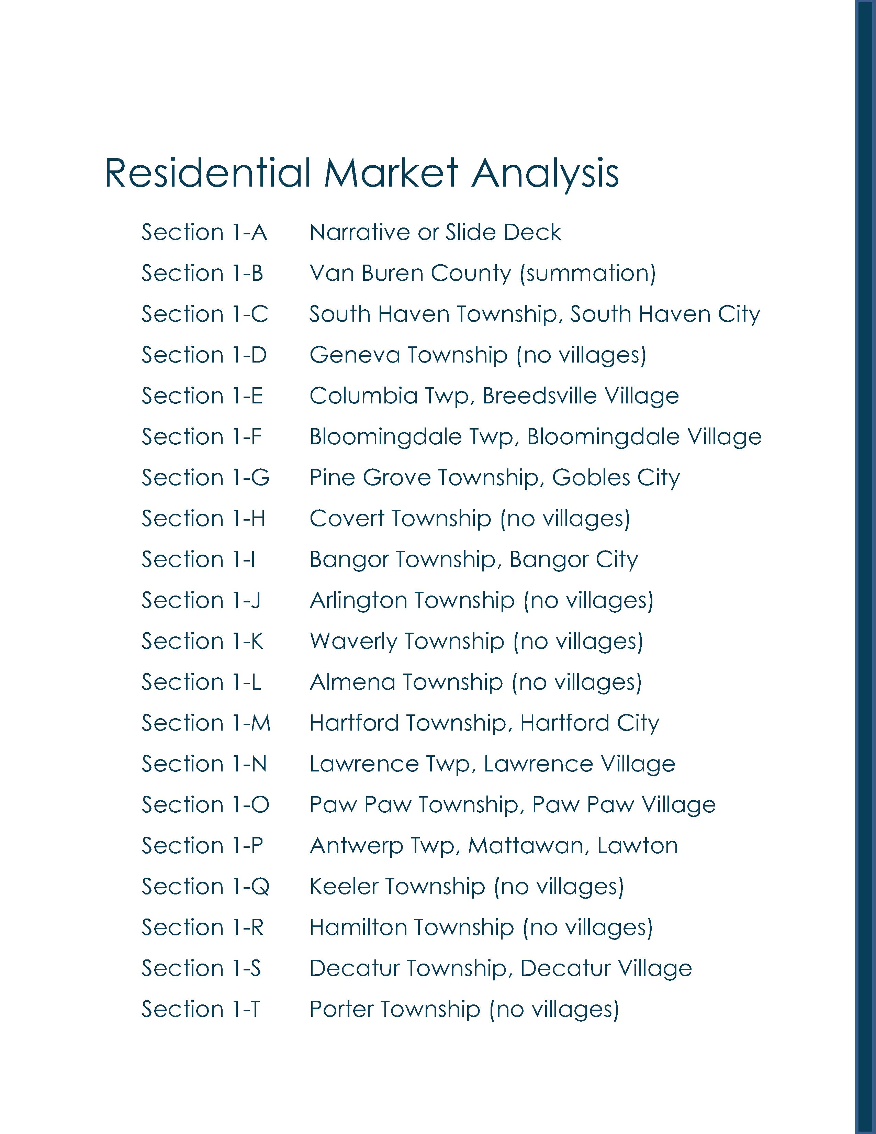
Van Buren County | Target Market Analysis | Potential

Slide 2


Van Buren County | Acknowledgements
Van Buren County Administration
Lisa Ransler, Community Services Director
Van Buren County Administration
219 E Paw Paw Street, Ste 302
Paw Paw, MI 49079
phone | 269-657-8200 x1073
email | ranslerl@vanburencountymi.gov
Market One Van Buren and Cass Counties
Economic & Community Development
Zachary Morris, Executive Director
32849 Red Arrow Hwy, Ste 100
Paw Paw, MI 49079
phone | (269) 519-6142
email | Morrisz@marketvanburen.org
Consultant
LandUseUSA | Urban Strategies
Sharon M. Woods, CNUa
President
Phone | (517) 290-5531
email | sharonwoods@landuseusa.com

Slide 3
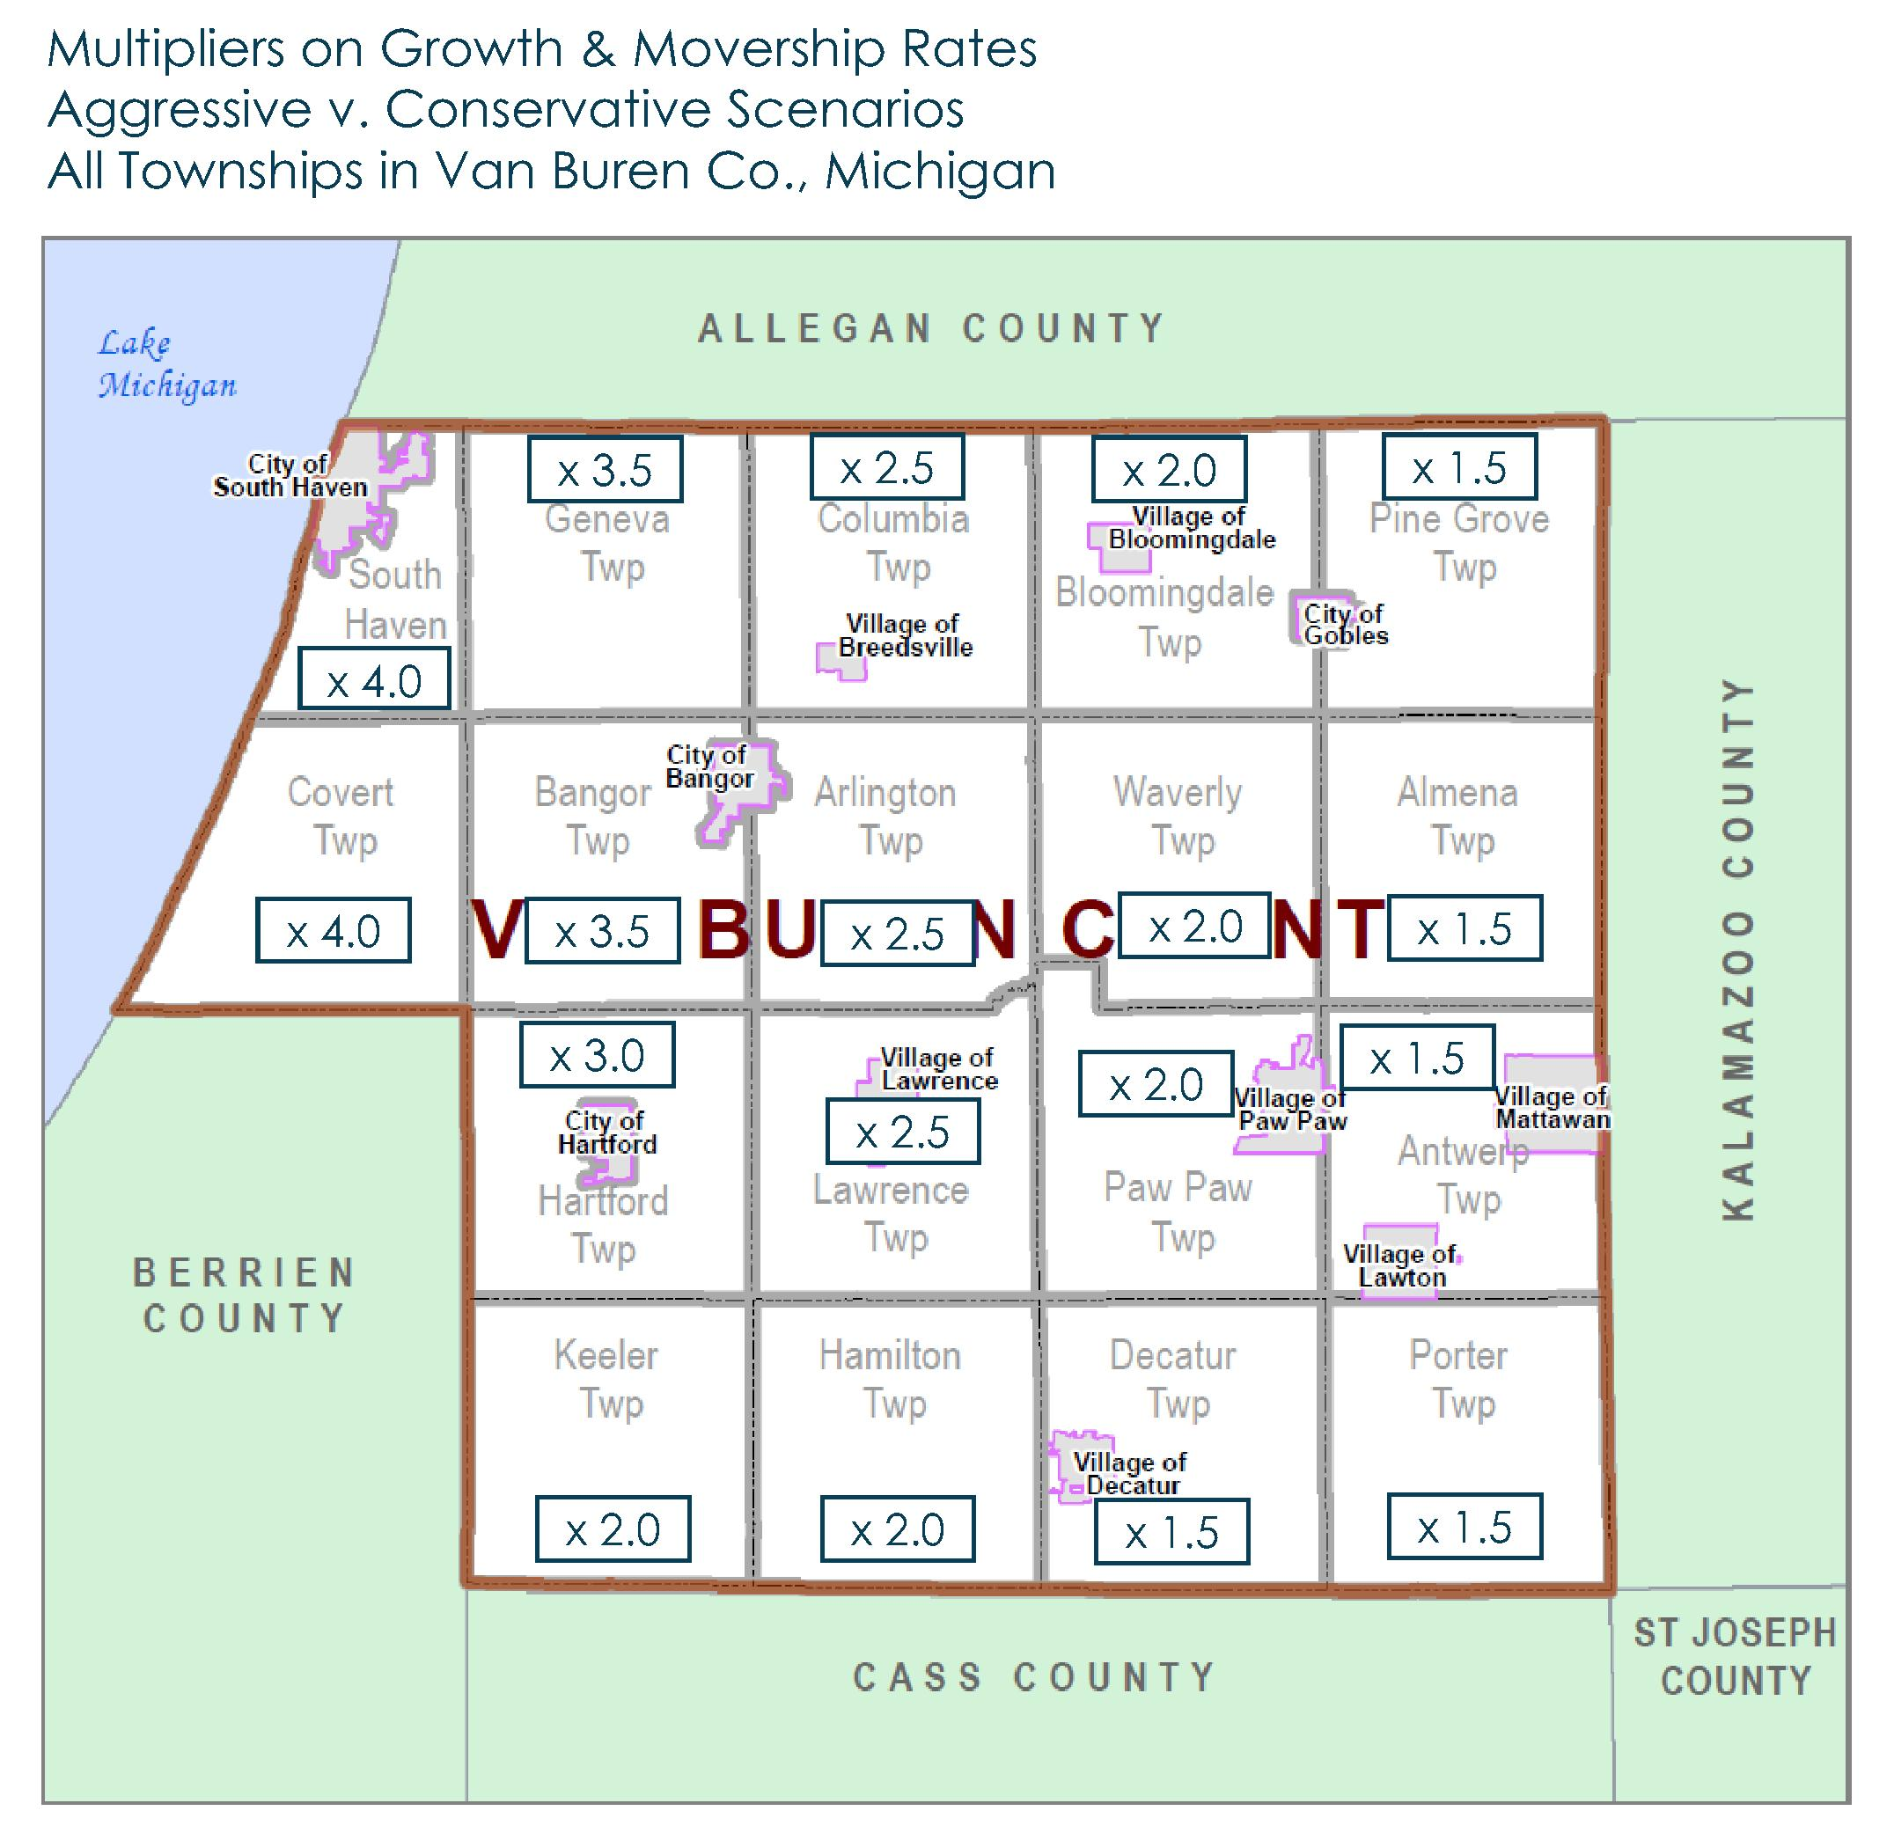
Van Buren County | Assumptions
The Van Buren Residential Target Market Analysis has been completed for each place in the county, including all townships, cities, and villages. With the county, they total 30 jurisdictions or entities. This narrative and slide deck focuses primarily on totals for Van Buren County. Stakeholders are encouraged to use this summary as a guide for twenty-nine (29) local places.
The analysis has been completed for an Aggressive (i.e., growth) and Conservative (i.e., status quo) scenarios. The aggressive scenario assumes a significant increase in demand for new housing based on a significant gain in new job opportunities at a re-opened Palisades Power Plant in west Covert Township, with economic trickle-through benefits for the county and region.
In general, the aggressive scenario assumes a multiplier effect of up to x4 (four times) that of the conservative scenario, applied to two inter-related variables. The multipliers have been applied to the movership rates (i.e., share of households that move in any given year); and the growth rate in the number of households.
To ensure that the results are realistic, attainable, and not artificially inflated, maximum thresholds also are applied. The analysis also assumes that the multiplier erodes with increasing distance from the Palisades Power Plant.
Sec
1-B

Slide 4


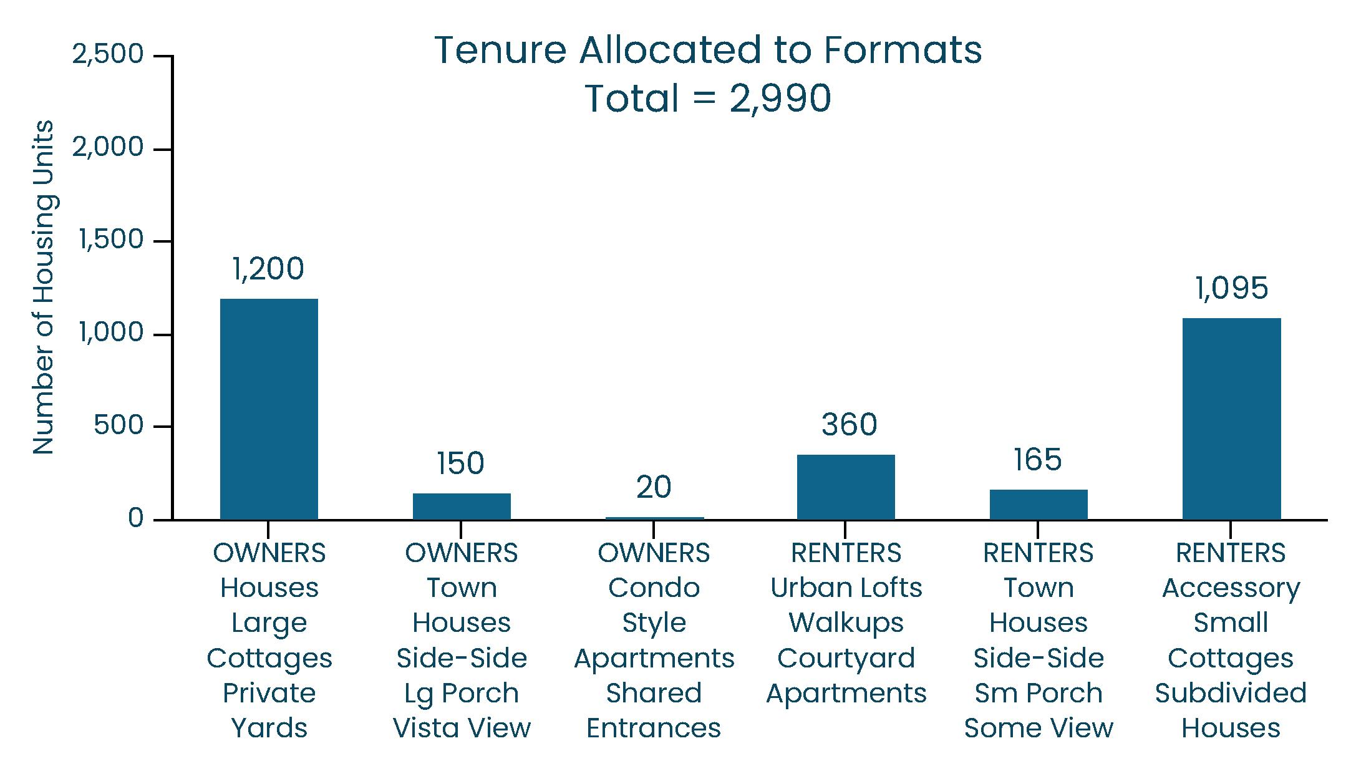
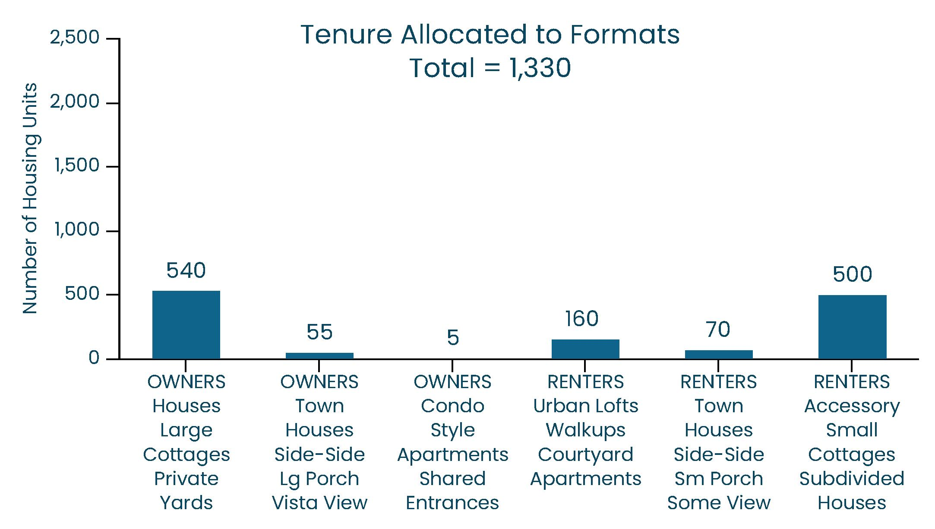
Van Buren Co | Total Market Potential
Aggressive Scenario – Within the entire Van Buren County, there could be a future maximum market potential, opportunity, and need to build up to (and no more than) 2,990 new-build units annually for the next five years. However, less than half (45% or 1,370 units, or) should be built for the owner market, and the majority (55% or 1,620 units) should be built for the renter market.
This growth scenario assumes a significant increase in housing demand attributable to a significant increase in new job opportunities spurred by re-opening of Palisades.
Conservative Scenario – Within the entire Van Buren County, there currently is a minimum market potential, opportunity, and need to build at least 1,330 new-build units annually for the next five years. However, less than half (45% or 600 units) units should be built for the owner market, and the majority (55%, or 730 units) should be built for the renter market.
This status quo scenario assumes that Palisades remains closed and that there there is not a significant increase in housing demand spurred by new job opportunities.
Sec
1-B

Slide 5
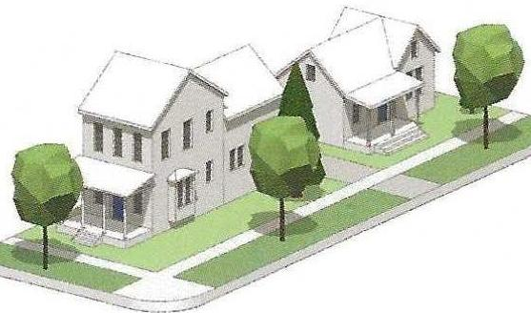
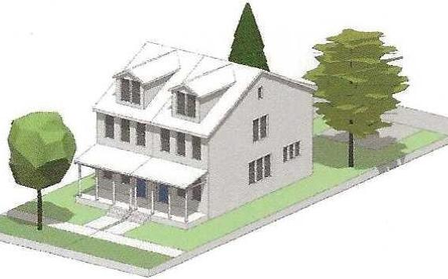
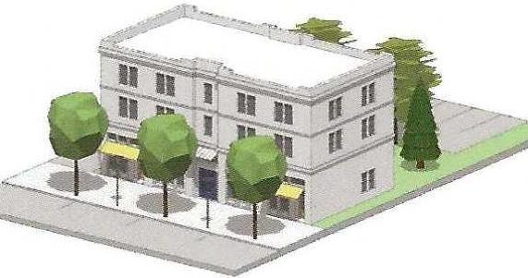
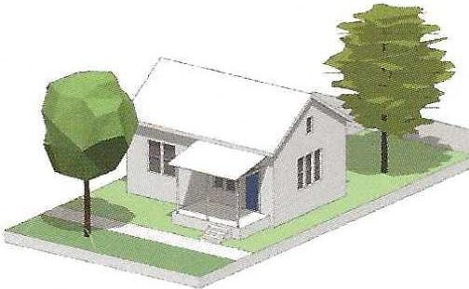
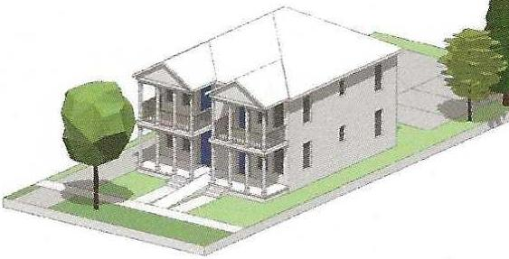
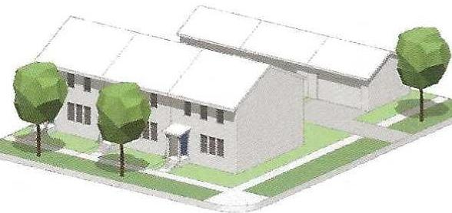
Van Buren Co | Aggressive Scenario
150
OWNER
Townhouses
20
OWNER
Condo-Style
Apartments
1,200
OWNER
Houses and
Large Cottages
360
RENTER
Urban Lofts,
Walkups,
Courtyard Apts
1,095
RENTER
Accessory Dwellings,
Small Cottages,
Subdivided Houses
165
RENTER
Townhouses
Sec
1-B

Slide 6
Van Buren Co | Conservative Scenario
55
OWNER
Townhouses
5
OWNER
Condo-Style
Apartments
540
OWNER
Houses and
Large Cottages
160
RENTER
Urban Lofts,
Walkups,
Courtyard Apts
500
RENTER
Accessory Dwellings,
Small Cottages,
Subdivided Houses
70
RENTER
Townhouses
Sec
1-B

Slide 7
Van Buren Co | Rehabs, Remodels, Renovations
New-Builds – The conservative scenario shown on this and prior slide are based on recent and actual in-migration of new households moving into Van Buren County’s townships, cities, and villages. In-migration is a reasonable representation of the number of new-build housing units that should be constructed each year.
Rehabs – In addition, there are an equal number of existing households moving within Van Buren County’s various places. In other words, they are moving from one address to another within the same community that they currently live. This internal movership is a reasonable representation of the number of rehabs that should be undertaken each year. Rehabs may include house hacks or expansions to add for-lease suites, efficiencies, or studios onto existing houses. They may also include other types of renovations, remodels, or improvements to existing units, ideally improving the quality of life for residents.
540
OWNER
Houses and
Large Cottages
55
OWNER
Townhouses
5
OWNER
Condo-Style
Apartments
160
RENTER
Urban Lofts,
Walkups,
Courtyard Apts
70
RENTER
Townhouses
500
RENTER
Accessory Dwellings,
Small Cottages,
Subdivided Houses
Sec
1-B

Slide 8
Van Buren Co | Owner Market Potential
Under the Aggressive Scenario, Van Buren County could have a future market potential to build up to 1,370 new residential units annually for the owner market. Among those new-builds, 1,200 units (nearly 90%) could be detached houses and/or cottages around shared courtyards.
The other 170 new-builds for the owner market may include side-by-side townhouses with balconies with downtown or waterfront views (including Lake Michigan and inland lakes). Apartment-style condos are reserved for waterfront settings only.
Under the Conservative Scenario, Van Buren County currently has a current market potential to build up to 600 new residential units annually for the owner market. Among these new-builds, all 540 units (90%) should be detached houses, and/or cottages around shared courtyards.
The other 60 new-builds for the owner market may include side-by-side townhouses with balconies with downtown or waterfront views (including Lake Michigan and inland lakes). Apartment-style condos are reserved for waterfront settings only.
Sec
1-B

Slide 9
Van Buren Co | Renter Market Potential
Within Van Buren County, the aggressive or growth scenario indicates a future potential to build up to 360 new units in urban formats with shared entrances. Examples include small apartment buildings (preferably with shared courtyards), urban-styled lofts over street-front retail, and walk-up buildings. Walk-ups typically have four lofts on each of three levels.
Within Van Buren County, the conservative or status quo scenario reveals a current potential to build up to 160 new units in urban formats with shared entrances. Examples include small apartment buildings (preferably with shared courtyards), urban-styled lofts over street-front retail, and walk-up buildings. Walk-ups typically have four lofts on each of three levels.
Sec
1-B

Slide 10
Van Buren Co | Renter Market Potential (continued)
Sec
1-B
Also in Van Buren County, the aggressive scenario suggests a future opportunity to build up to 165 new for-lease townhouses with private entrances, which may include side-by-side duplexes or triplexes with balconies and water views (or breezes); or townhouses with small porches overlooking traditional downtowns.
In addition, there could be a future opportunity to build up to 1,095 new rental units in detached buildings like apartment houses, cottages, and/or accessory dwellings. Cottages are ideal for clustering around shared courtyards, town squares, and community parks.
Also in Van Buren County, the conservative scenario indicates a current opportunity to build up to 70 new for-lease townhouses with private entrances, which may include side-by-side duplexes or triplexes with balconies and water views (or breezes); or townhouses with small porches overlooking traditional downtowns.
In addition, there already is a current opportunity to build up to 500 new rental units in detached buildings like apartment houses, cottages, and/or accessory dwellings. Cottages are ideal for clustering around shared courtyards, town squares, and community parks.

Slide 11
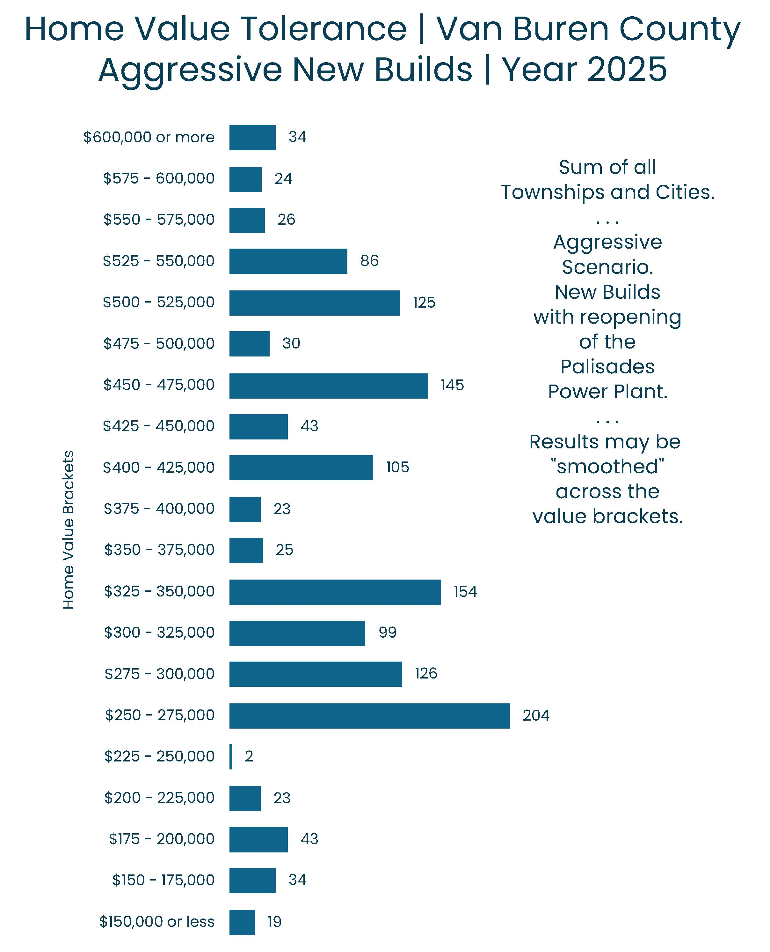
Van Buren Co | Home Value Tolerance
Although there currently is an annual market potential for up to 1,370 new-build units for in-migrating owners (under the Aggressive Scenario), only a few of them will tolerate high prices. About one-third (1/3) will seek new-build choices that are priced at $300,000 or less, and only one-third (1/3) will tolerate prices of $450,000 or more.
These same ratios may be applied to the Conservative Scenario, with one-third of the new buyers hoping to find something priced at $325,000 or less, and one-third tolerating prices of $400,000 or more.
In general, detached houses with private yards, front porches, and garages should have the highest prices. In comparison, attached townhouses may have relatively lower prices than detached houses.
Among the new townhouses, end units with windows on two sides, balconies, and views of shared courtyards, town squares, or community parks may have higher prices than the inside units with alley views.
Sec
1-B

Slide 12
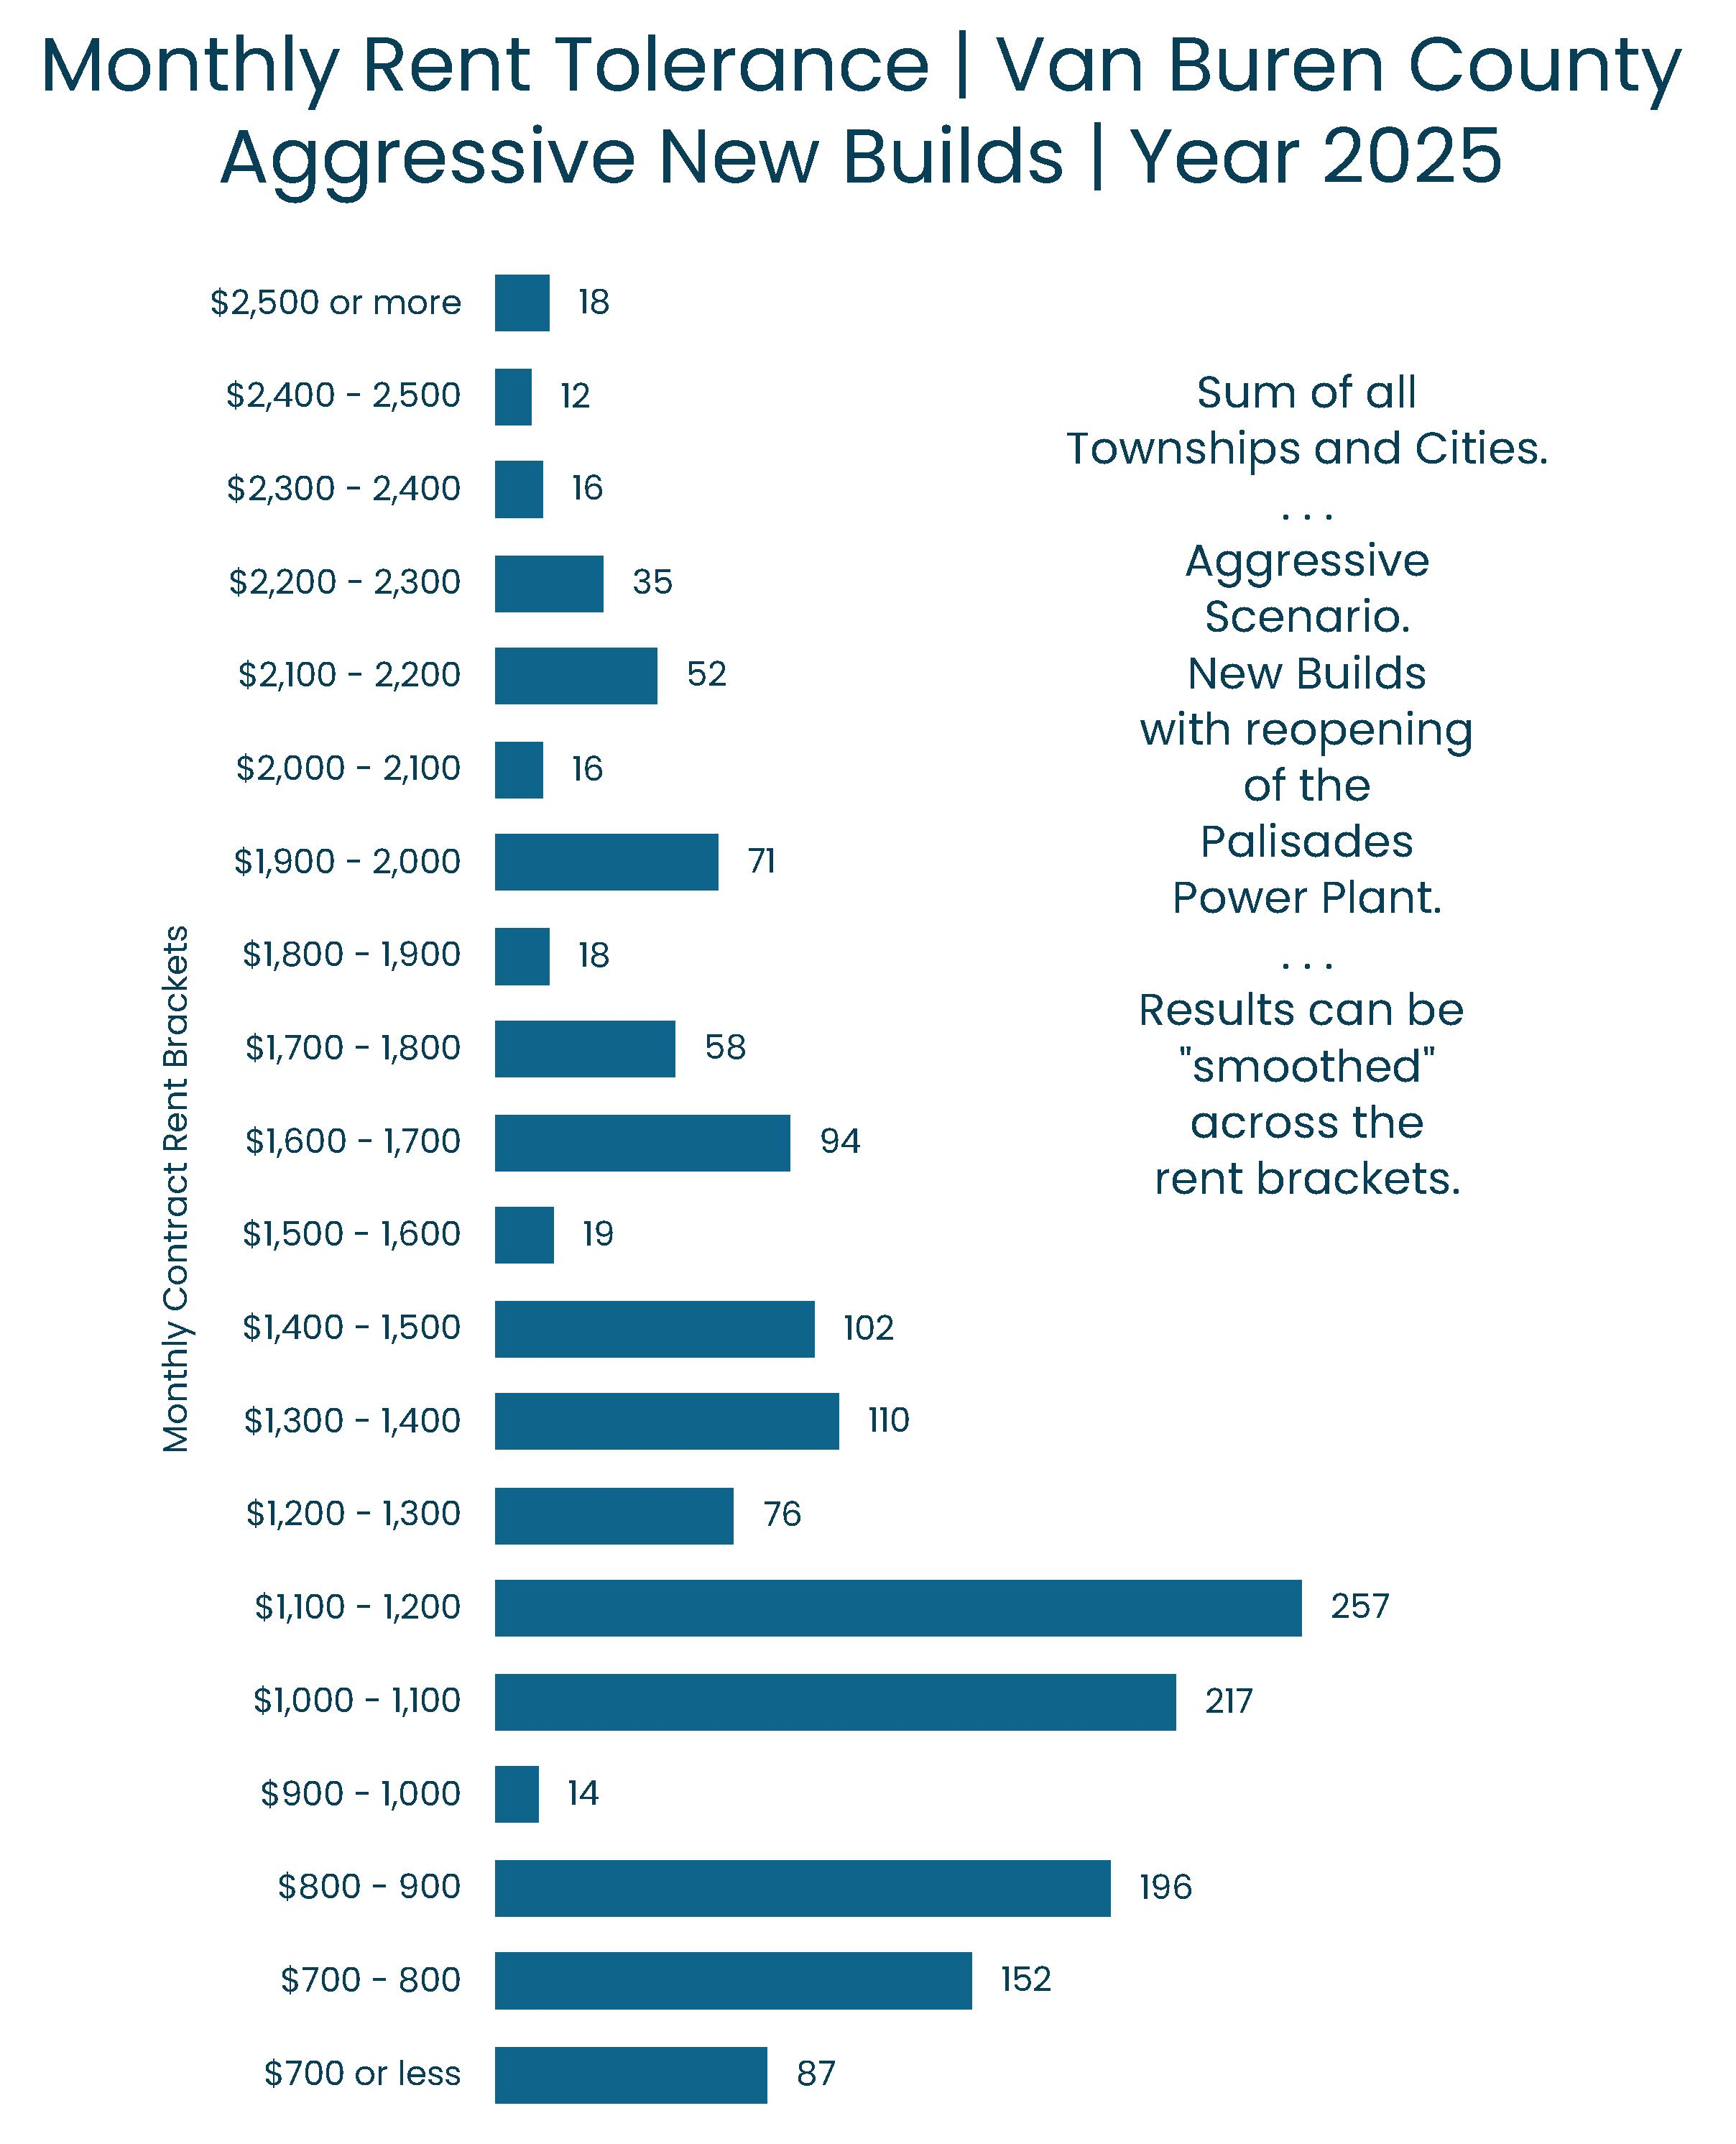
Van Buren Co | Monthly Rent Tolerance
Although there currently is an annual market potential for up to 1,620 new-build units for in-migrating renters, only a few of them will tolerate high prices. Roughly one-third (32%) of the new renters will seek new-build choices with monthly contract (cash or net) rents of $900 or less, and only one-third (28%) will tolerate rents $1,400 or more.
In general, buildings like apartment houses, town houses, and cottages with private entrances and garages should have the highest prices. In comparison, courtyard apartments and lofts (including those over street-front retail) with uncovered parking should have relatively lower prices.
However, some exceptions may apply, and a few luxury downtown lofts in historic buildings (i.e., above street-front retail) might capture exceptionally high rents.
Again, units with balconies should have a price premium – especially if they include views or glimpses of the downtown (and/or nightlife), or shared courtyards or town squares.
Sec
1-B

Slide 13
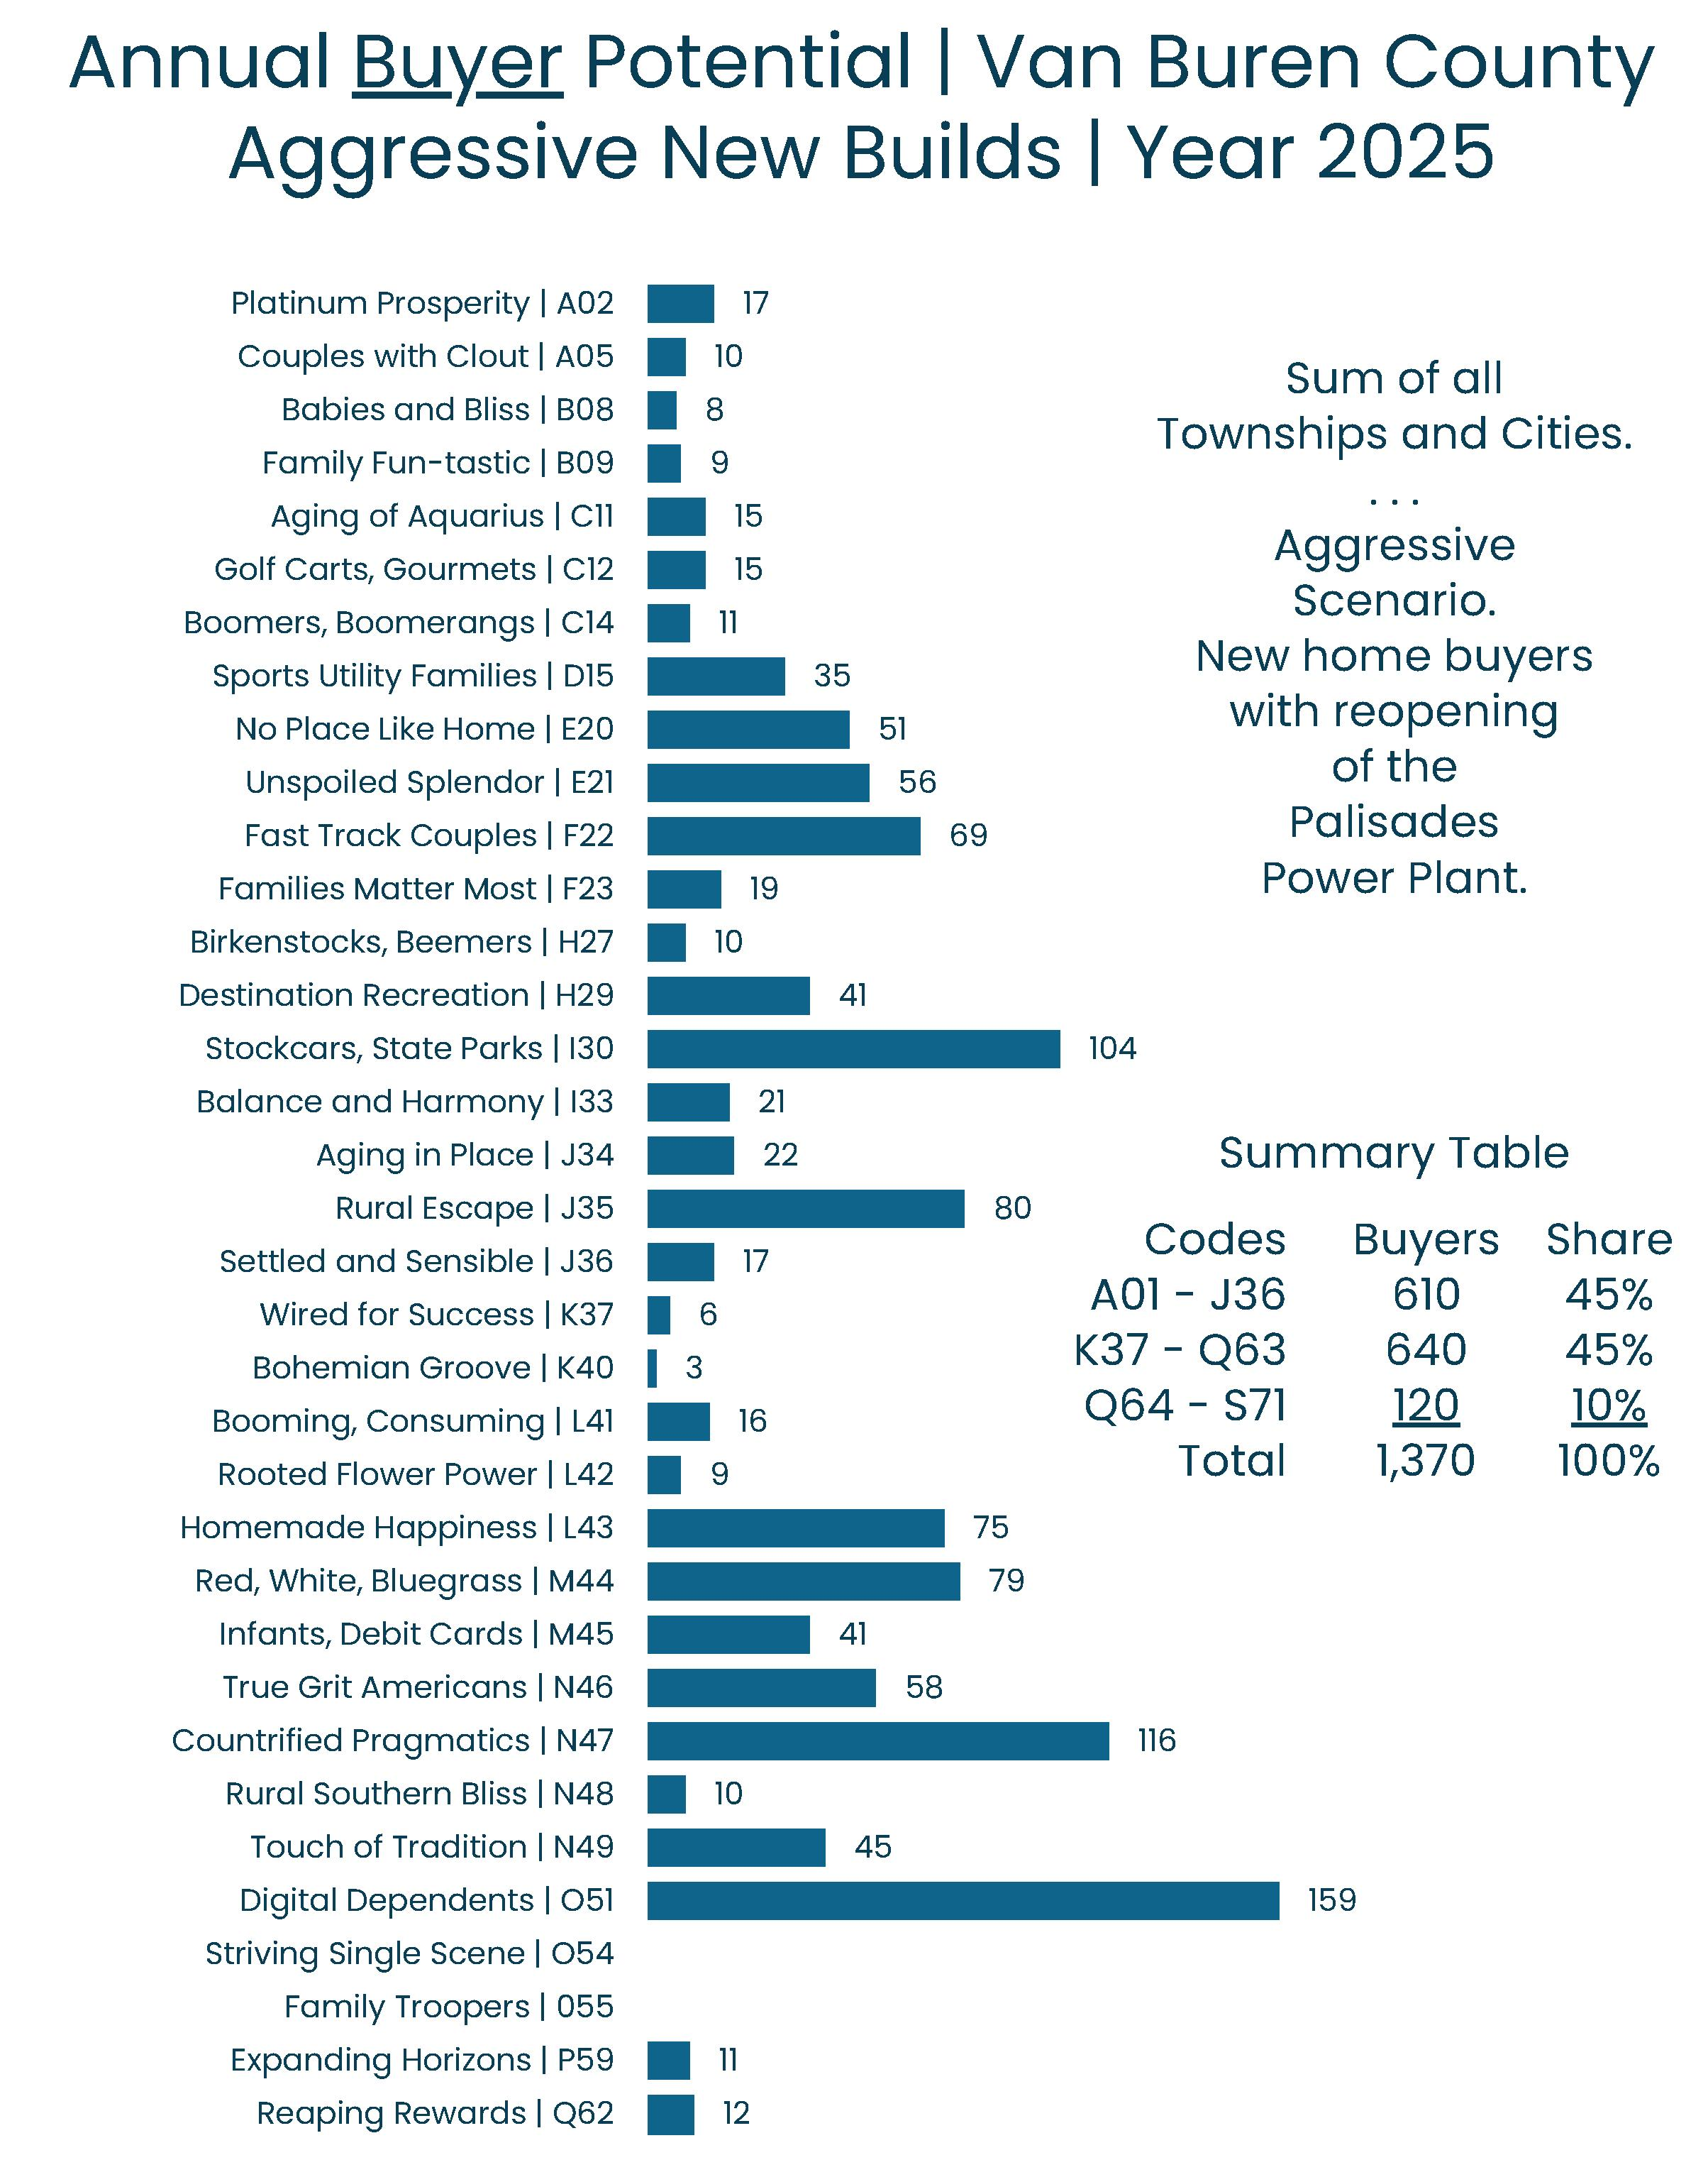
Van Buren Co | Buyer Target Markets
Among the 1,370 new owner households that could migrate into Van Buren County each year (i.e., under the Aggressive Scenario), 159 are likely to be Digital Dependents (reliant on hand-held devices like cell phones).
In addition, 116 of the new owner households probably will be Countrified Pragmatics (living modestly and pragmatically in the countryside). Similar target markets will include Rural Escape (80 households), Red White Bluegrass (79), Homemade Happiness (75), True Grit Americans (58), and Unspoiled Splendor (56).
In addition, about 104 households will align with Stock Cars and State Parks. Similar target markets will include Destination Recreation (41 households) and Sports Utility Families (35). All of these lifestyle clusters may be considered among the primary “target markets” for new-build units in Van Buren County.
Note: The overall profile or composition of target markets is likely to be proportionately similar under both the Conservative and Aggressive Scenarios. In other words, it is unlikely that significant job creation in the market would significantly change the profile of the target markets.
Sec
1-B

Slide 14
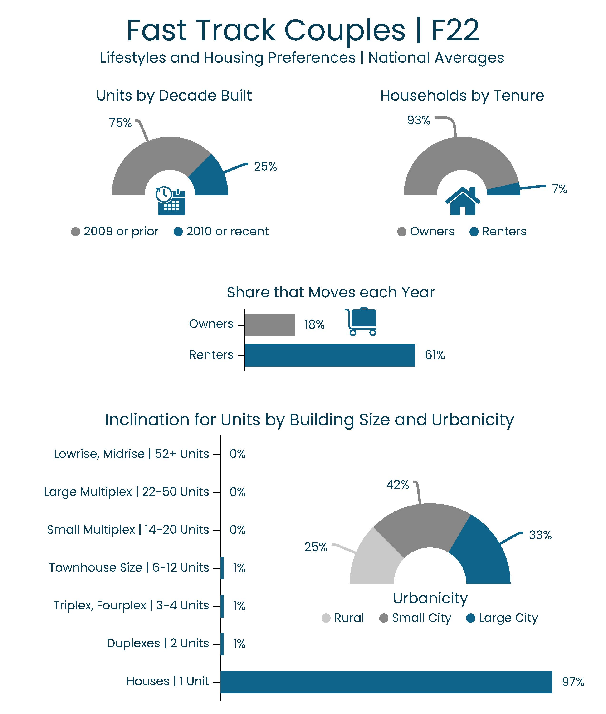
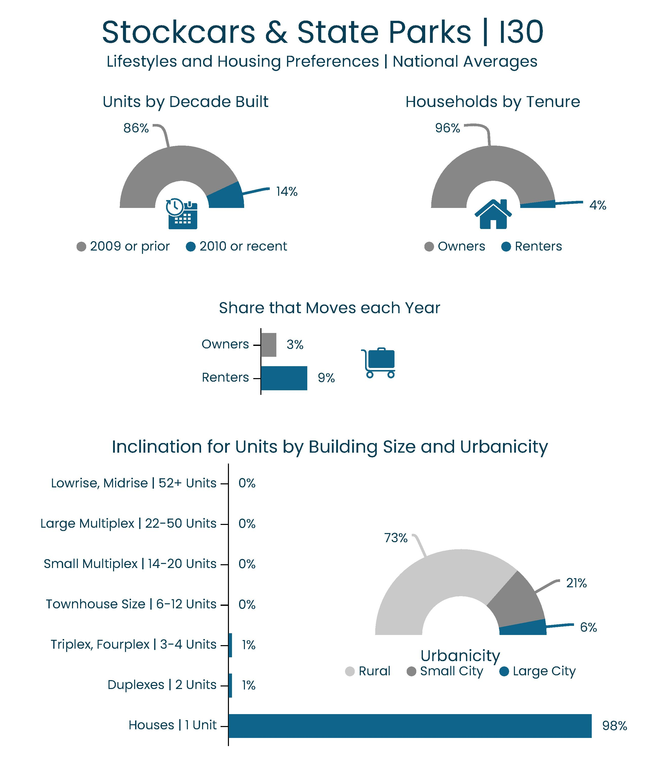
Van Buren Co | Buyer Target Markets
Among the 1,370 new owner households that could migrate into Van Buren County each year (under the Aggressive Scenario), sixty-nine (69) of them are likely to be Fast Track Couples. Therefore, this lifestyle cluster is a primary target market for new-builds.
Based on national averages, about 93% of Fast Track Couples tend to be home owners, and only 7% are renters. Among the owners, 18% move every year. Side note: 18% is high compared to the national average of 5% for all owner households.
Among the 1,370 new owners households that could migrate into Van Buren County each year (under the Aggressive Scenario), 104 of them are likely to be affiliated with the Stockcars & State Parks target market. In this group, 96% are likely to be owners, but only three percent (3%) are likely to move in any given year. Side note: 3% is low compared to the national average of 5% for all owner households.
These differences in behavioral attributes among the target markets have been fully integrated into the housing analysis and gap model.
Note: larger images are provided on the next slide.
Sec
1-F

Slide 15
Van Buren Co | Buyer Target Markets
Sec
1-F

Slide 16
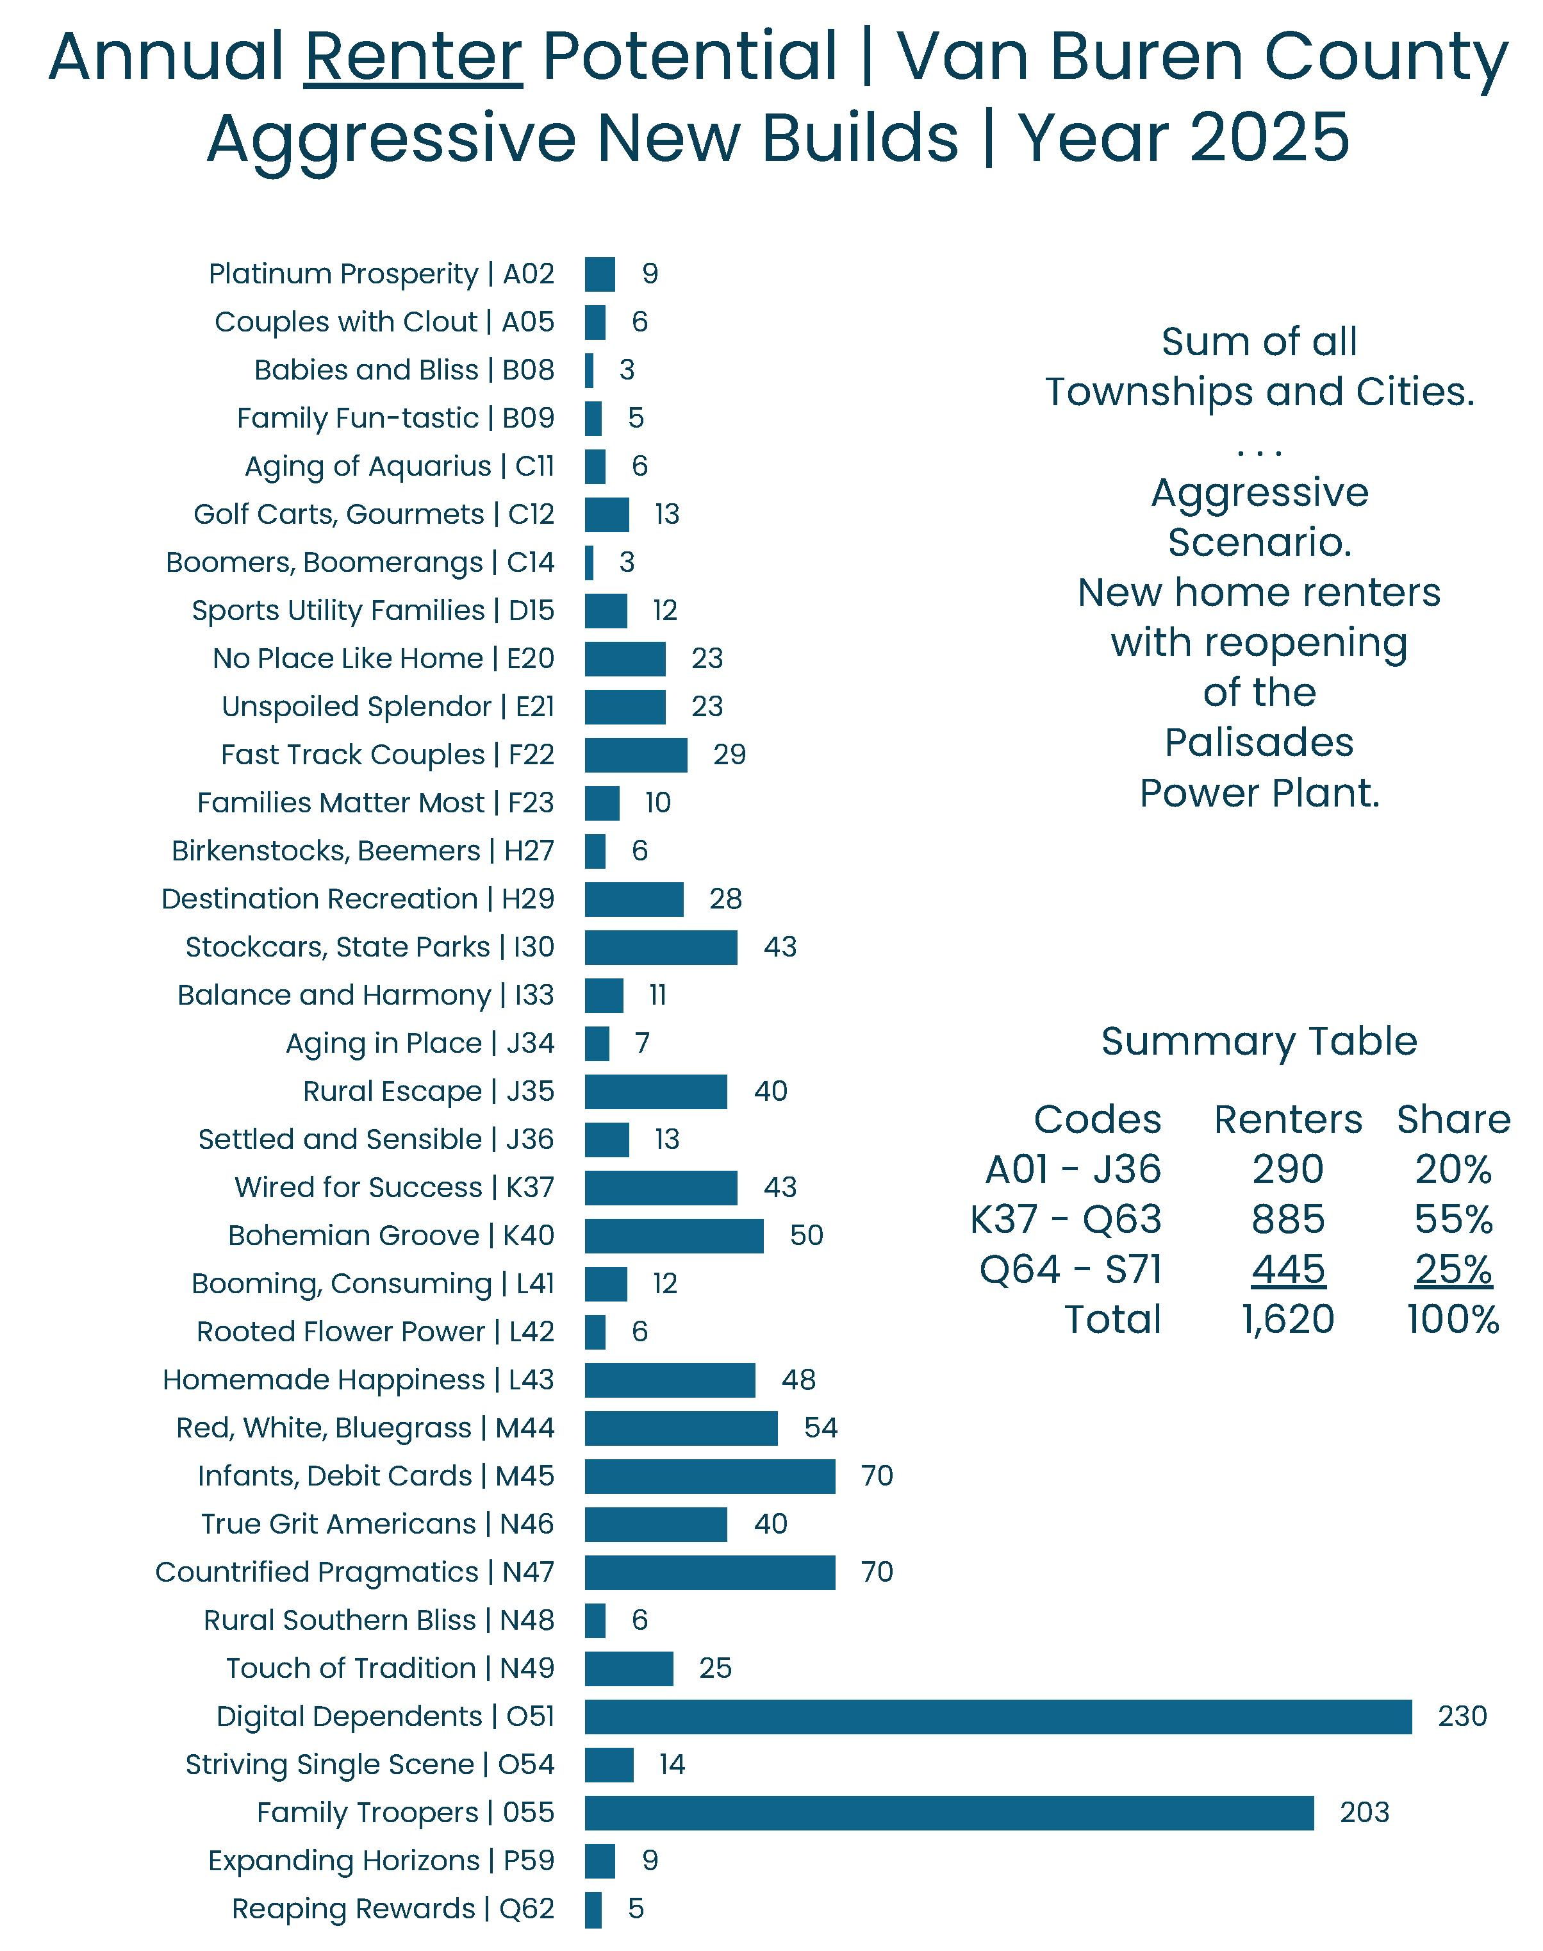
Van Buren Co | Renter Target Markets
Among the 1,620 new renter households that could migrate into Van Buren County each year (under the Aggressive Scenario), about 230 are likely to be affiliated with the Digital Dependent target market. In addition, 203 are likely to be Family Troopers (i.e., military, security, and safety workers).
Smaller numbers of new households are likely to be among the Infants and Debit Cards (70), Countrified Pragmatic (70), Red White Bluegrass (54), Bohemian Groove (50), and Homemade Happiness (48) target markets. They all are among the primary target markets for new-build rental units in Van Buren County.
Again, the overall profile or composition of target markets is likely to be proportionately similar under both the Conservative and Aggressive Scenarios. In other words, it is unlikely that significant job creation in the market would significantly change the profile of target markets.
Sec
1-B

Slide 17
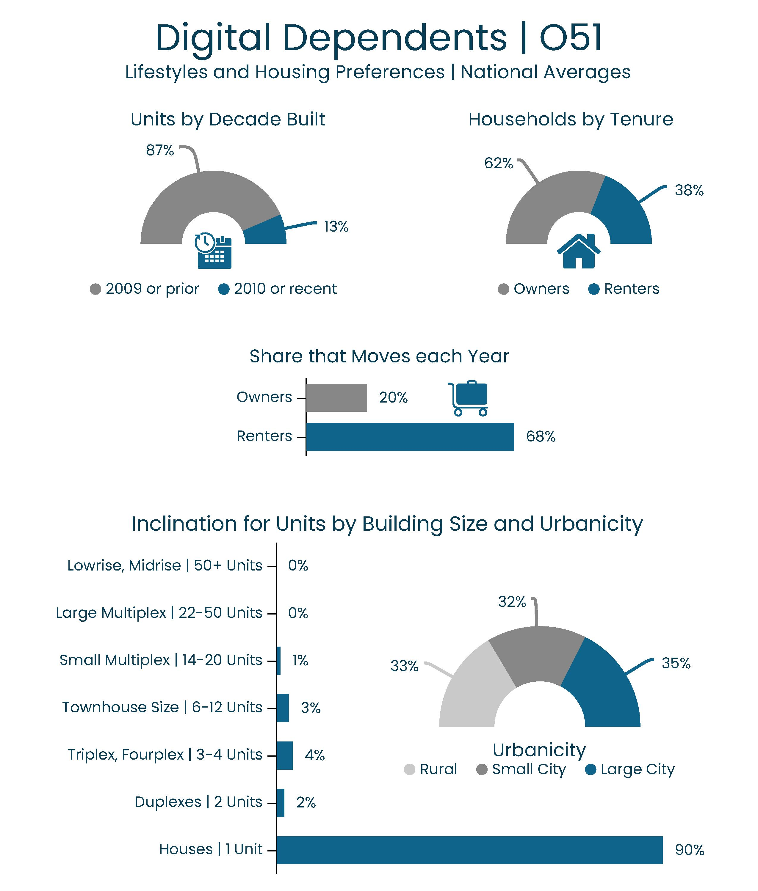
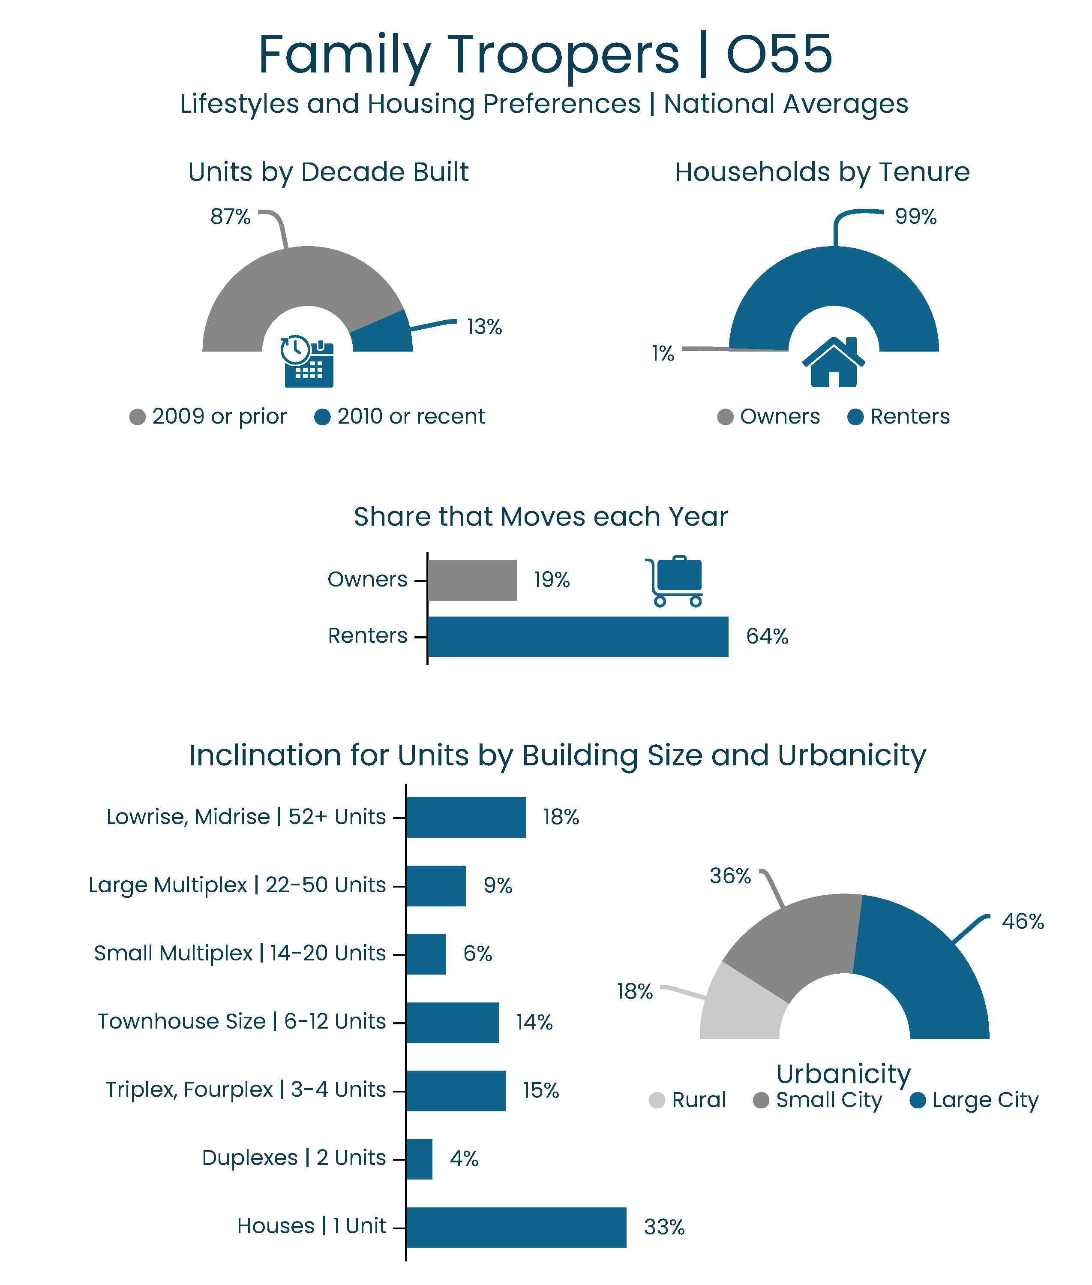
Van Buren Co | Renter Target Markets
Again, 230 of the new renter households that could potentially migrate into Van Buren County (under the Aggressive Scenario) are likely to be Digital Dependents. Based on national averages, about one-third (38%) of Digital Dependent households are likely to be renters, and 68% of those renters move each year. This is exceptionally high compared to the national average of about 25% for all renters combined.
However, only 10% of the Family Trooper households will choose an attached unit that shares a building entrance. The vast majority (90%) will prefer to rent a unit with a private entrance, such as a townhouse, cottage, apartment house, or accessory dwelling.
For another comparison, nearly all (99%) of the Family Trooper households are inclined to be renters, and about 64% of them are likely to move in any given year. However, only one-third (33%) would search for a detached unit with a private entrance, and two-thirds (66%) are more likely to search for other formats.
Again, these differences in behavioral attributes among the target markets have been fully integrated into the housing analysis and gap model.
Note: larger images are provided on the next slide.
Sec
1-F

Slide 18
Van Buren Co | Renter Target Markets
Sec
1-F

Slide 19
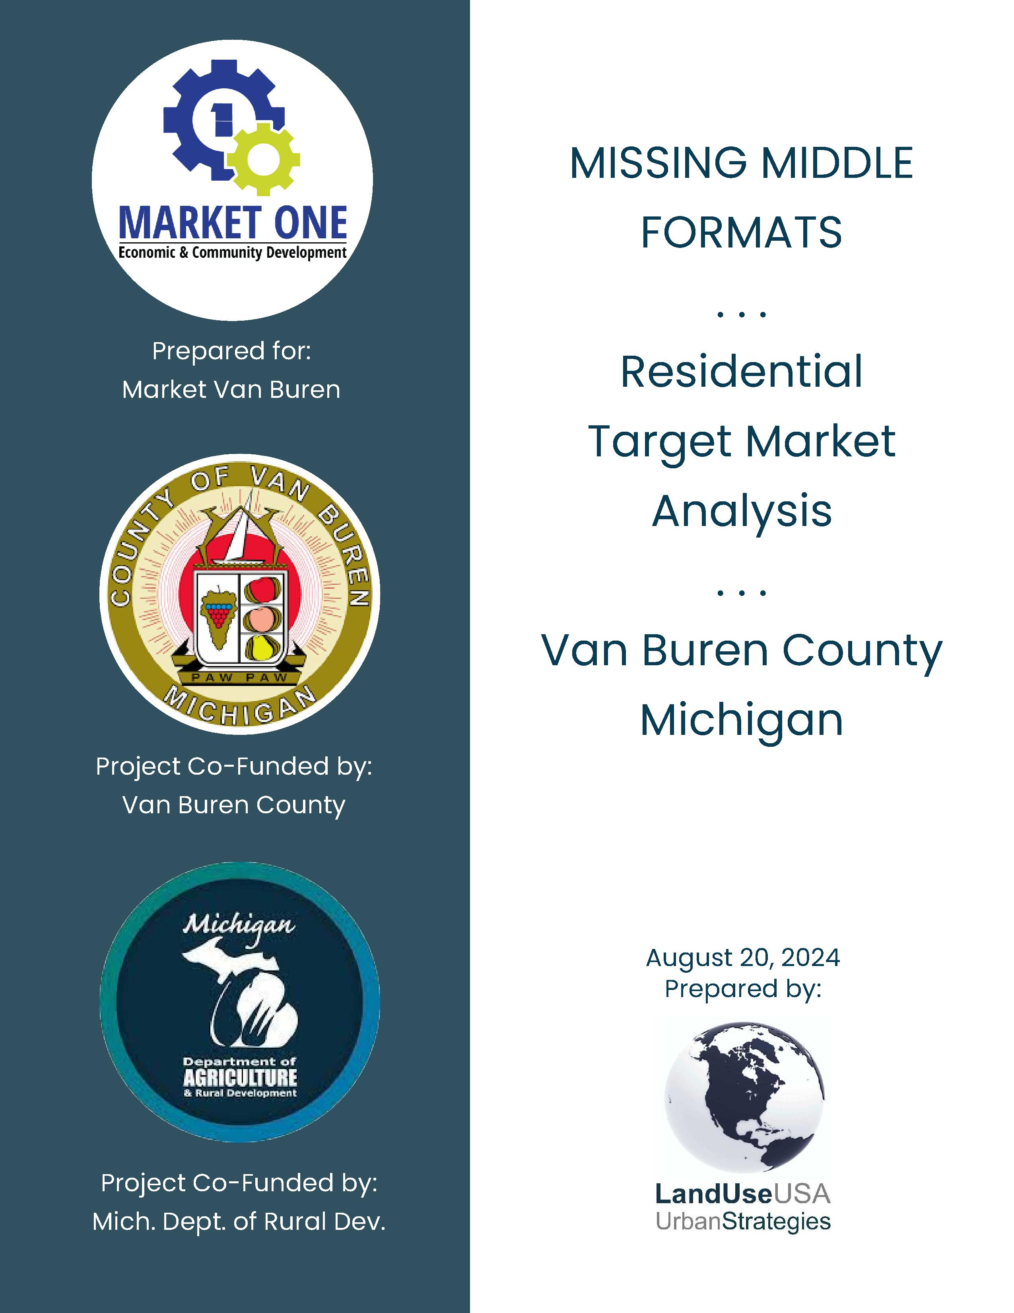

Van Buren County | Real Estate Analysis

Slide 20
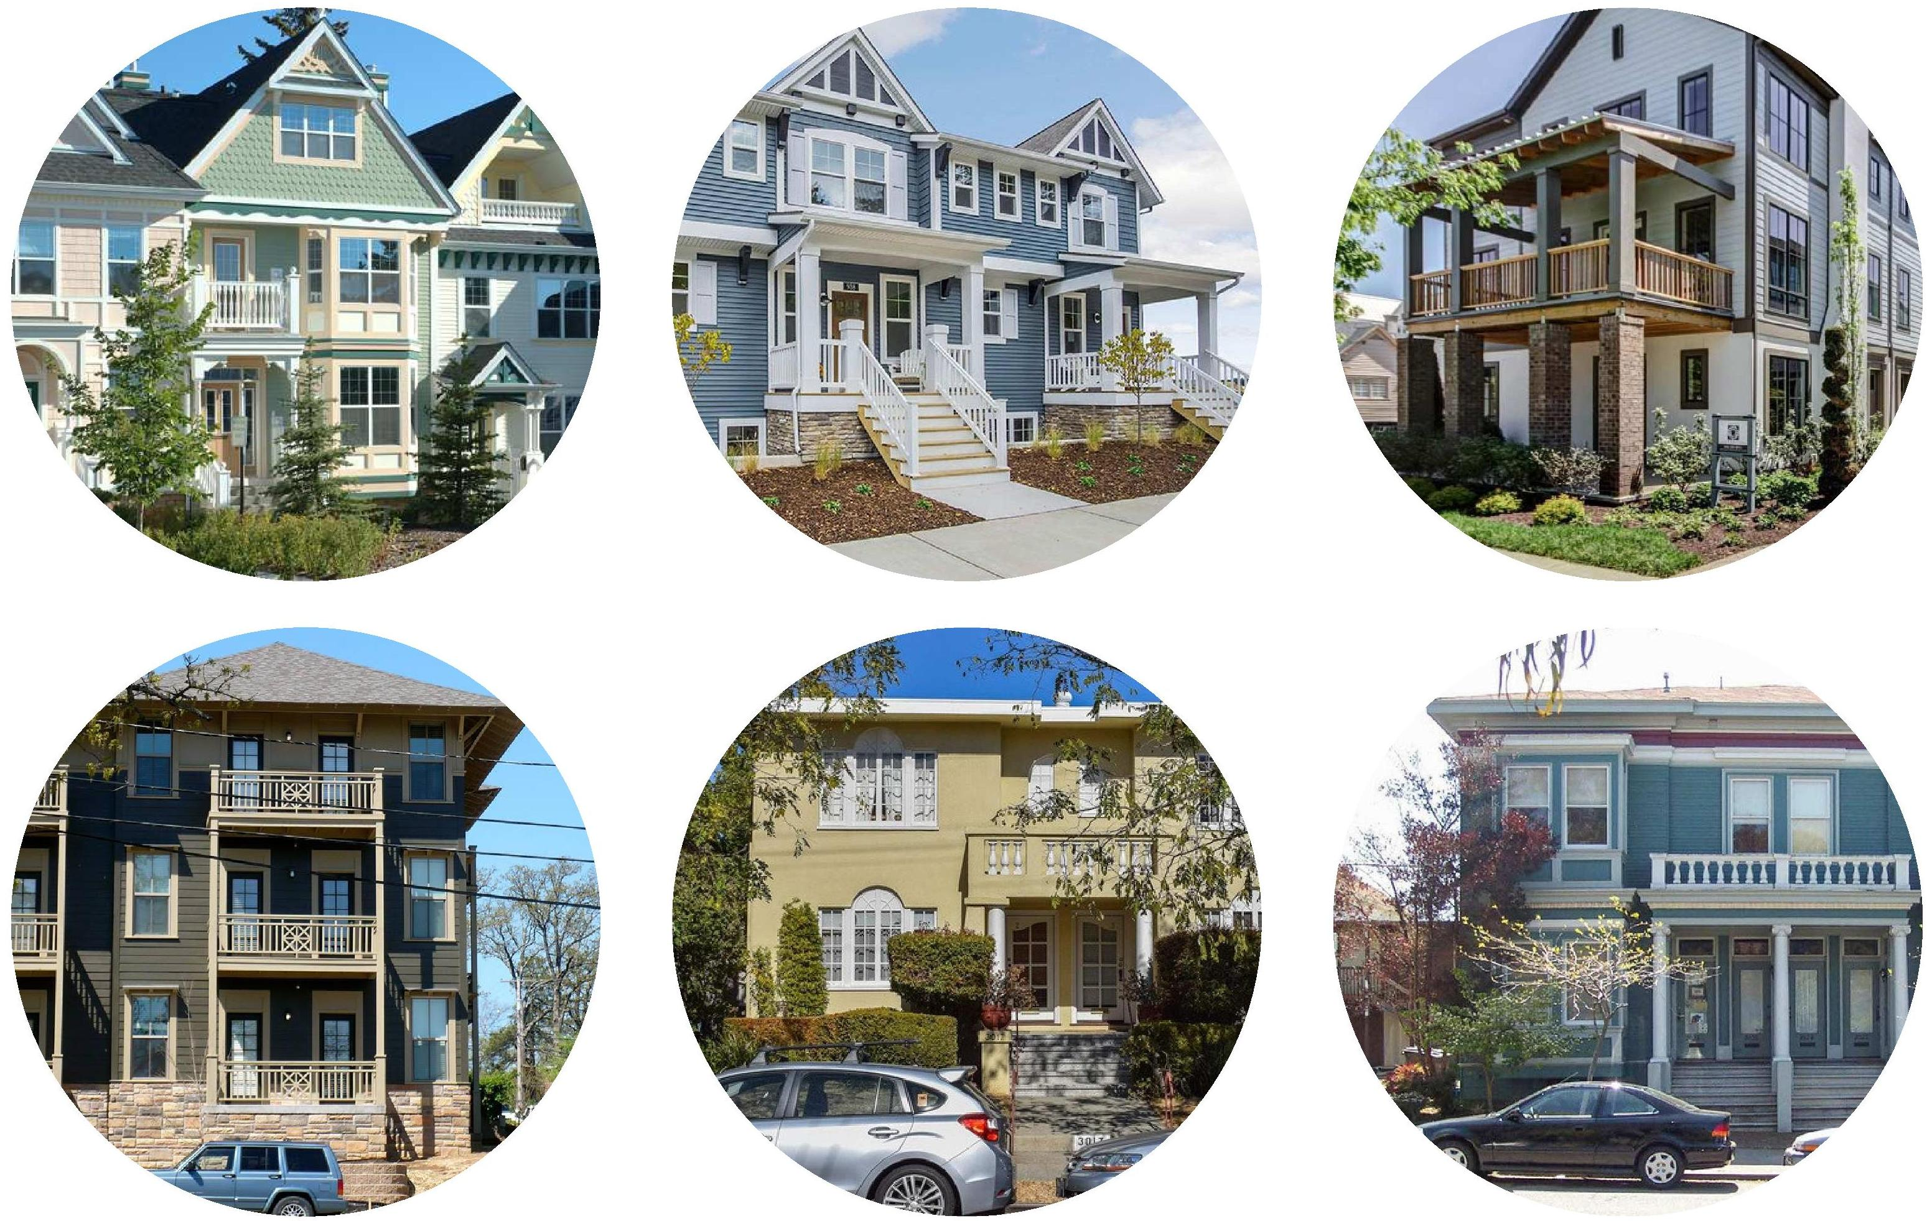
Van Buren County | Examples
A variety of photos are provided to convey a range of building sizes and formats, and generally organized from small to large. The smallest buildings may include detached accessory dwellings, followed by detached cottages, small houses, medium houses, duplex buildings, apartment houses, walkups, multiplexes, lofts, and courtyard apartments.
Building sizes and formats do not align with unit sizes. For example, an apartment house could have several studio or efficiency apartments, plus larger two-bedroom apartments. Similarly, townhouses could include small garden apartments in the basements, stacked by larger two-story townhouses above.
Mixed-income buildings with a range of units sizes can help encourage socio-economic diversity within communities. Again, accessory dwellings can be added among detached houses, garden apartments can be included below townhouses, and studios or efficiencies can be mixed in with larger apartments.
Within multiplexes, the largest units with the highest rents should have the upper-level corners (i.e., with windows on two sides) with the best views (i.e., overlooking the downtown). Smaller units should be in middle (with windows on one side), on the lower levels, and might have alley views.
Sec
5-B

Slide 21
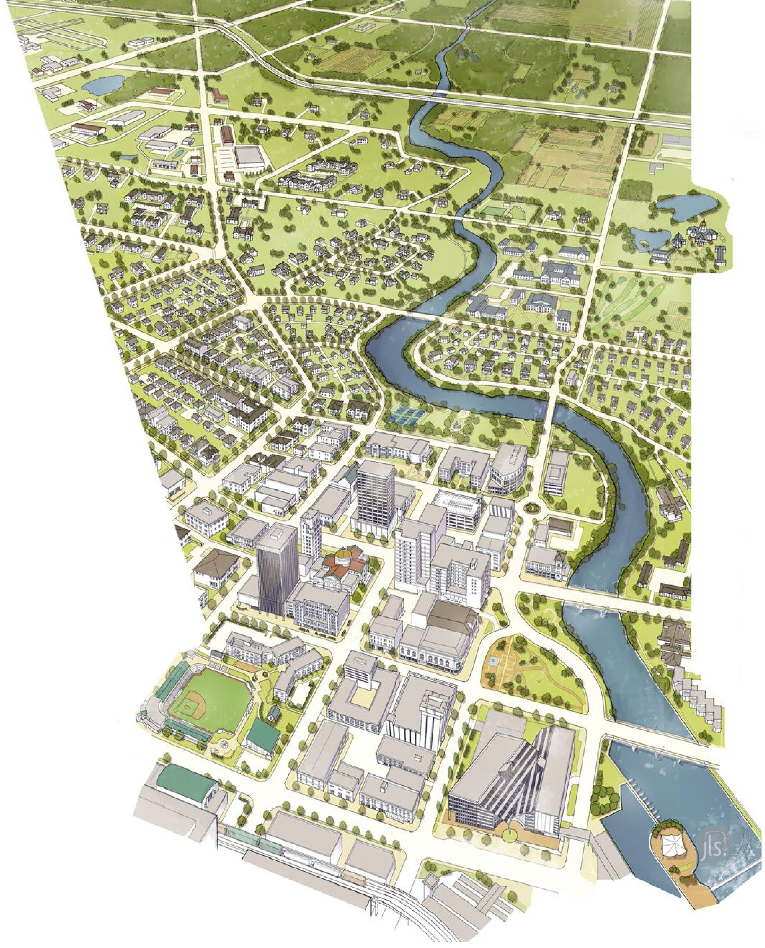

City of South Bend | Zoning Ordinance and FBC
The City of South Bend’s Department of Community Investment’s planning team developed and implemented a new, streamlined zoning ordinance that took effect in 2020, and that resulted in an increase in completed projects and fewer variance requests.
In 2021, the city was announced as the winner of the annual Richard H. Driehaus Form-Based Code Award, an annual prize for achievement selected by the Form-Based Codes Institute for the writing and implementation of zoning codes.
Excerpts from the city’s code are provided as an example of how the tool can be adapted across the complete rural-to-urban transect. Other communities sometimes take a “hybrid” approach, which integrates elements of form based planning into more conventional master plan updates.
The city’s code also includes a useful building typology for detached houses, cottage courts, duplexes, townhouses, apartment houses, stacked flats (a.k.a., lofts in walkup buildings), and shop buildings (a.k.a., lofts above street front retail). Excerpts are provided on the next slide.
Sec
5-C

Slide 22
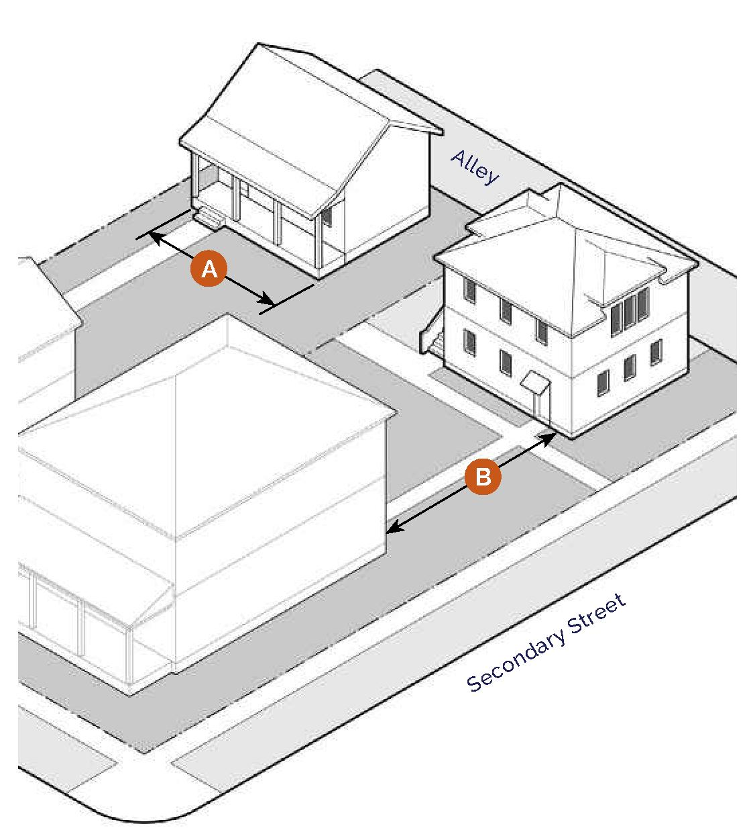
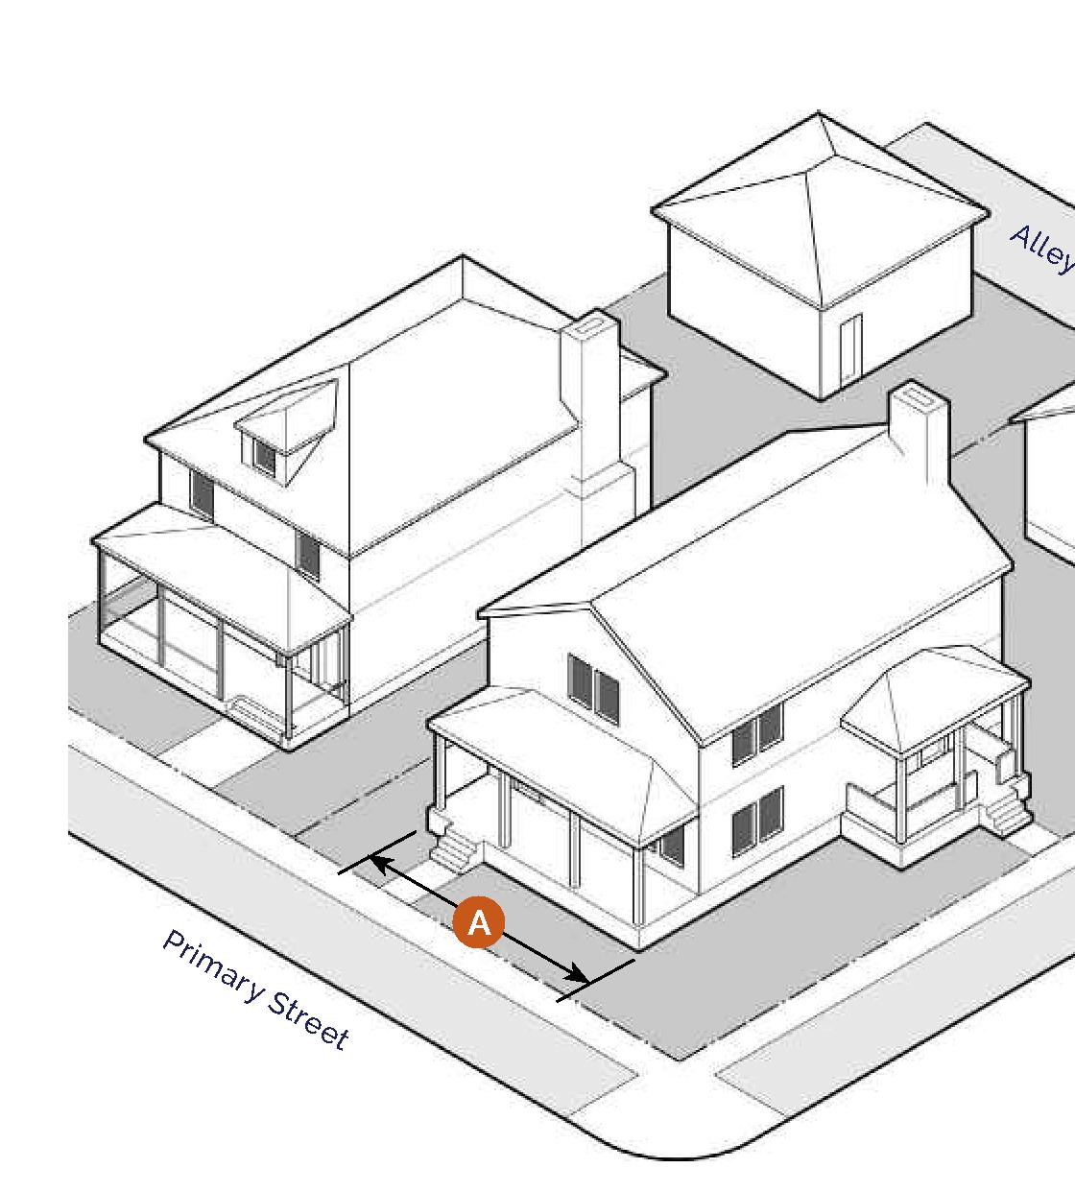
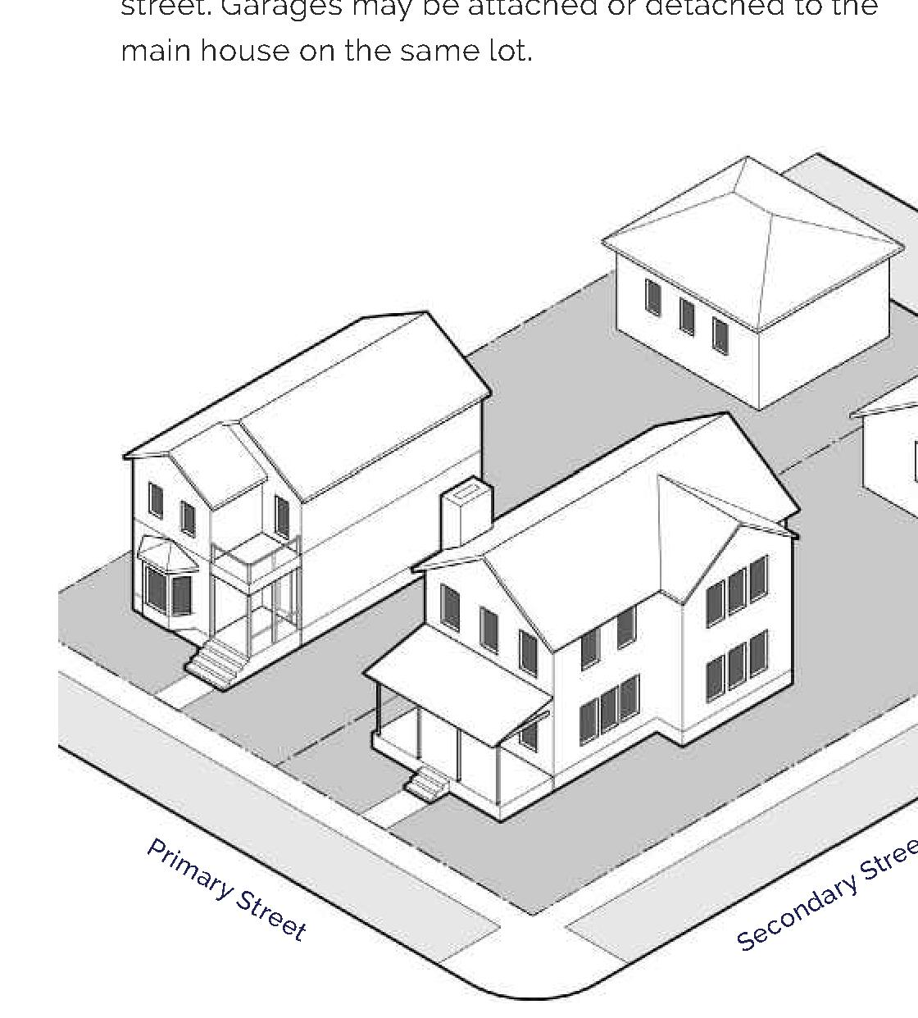
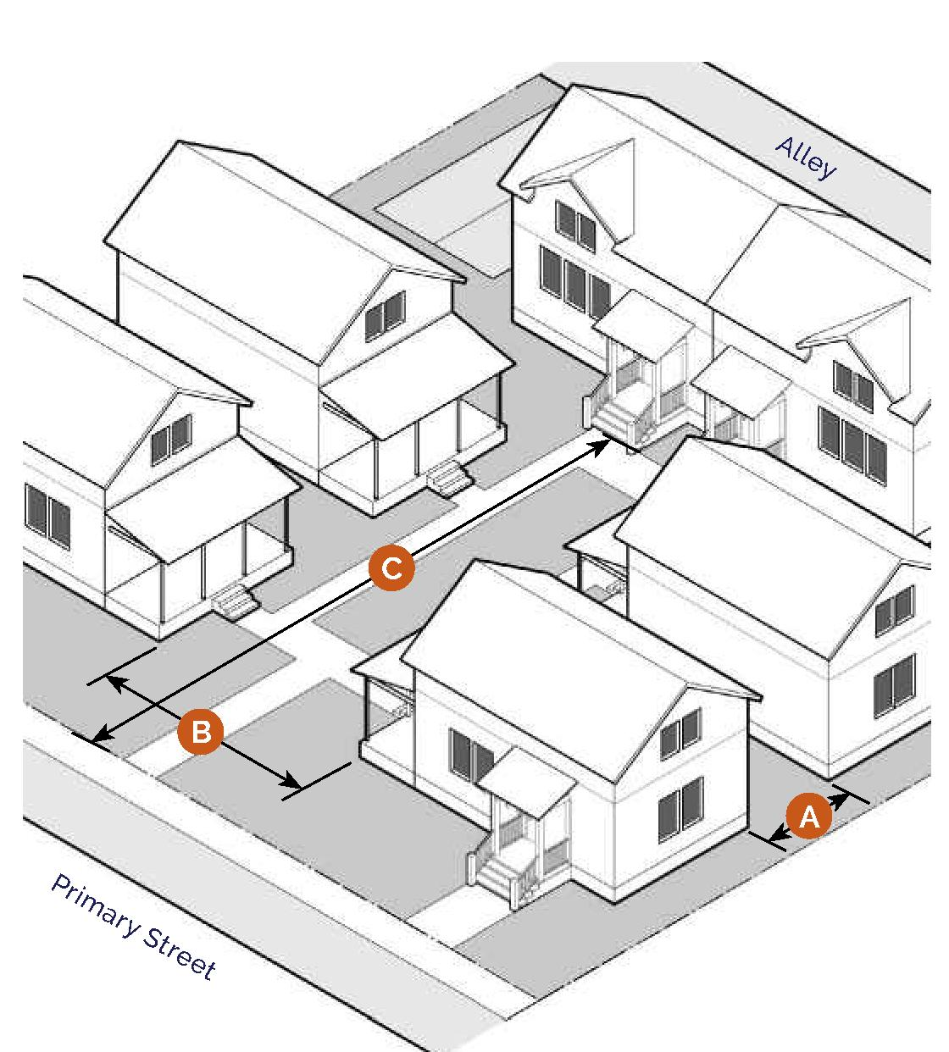
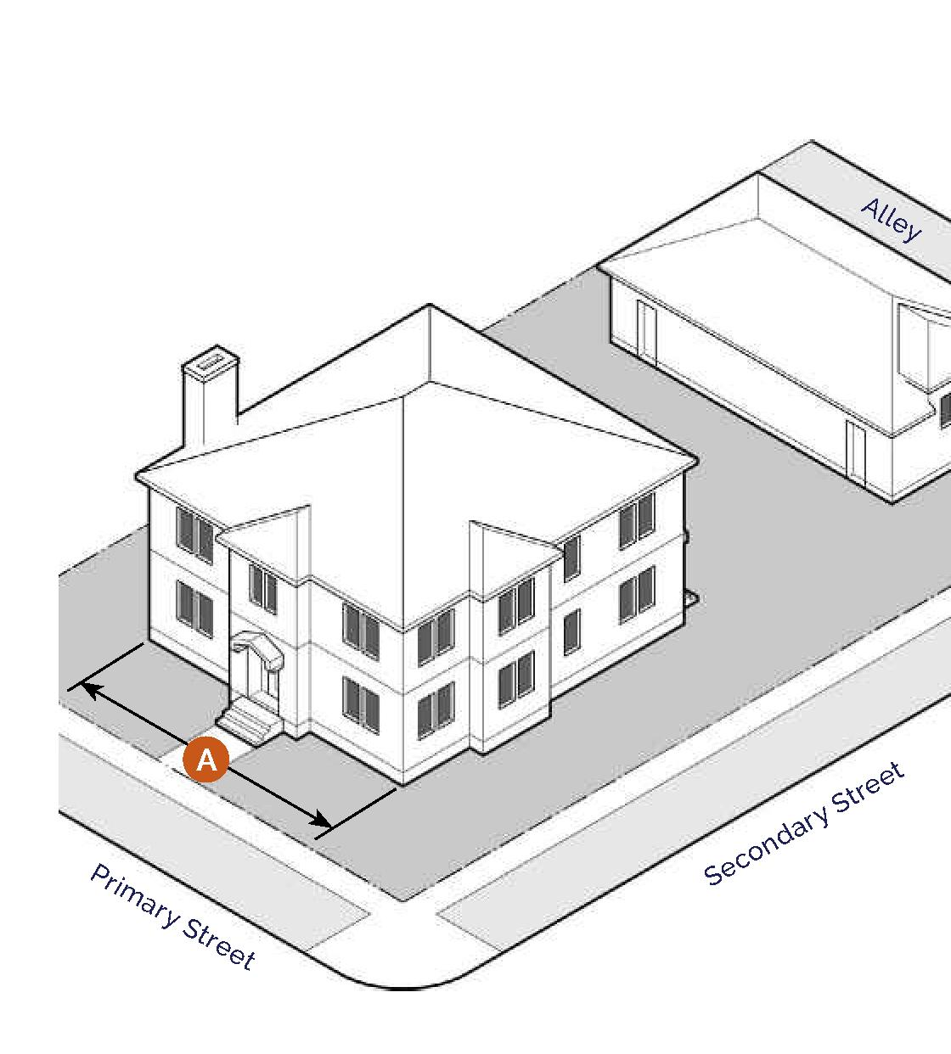
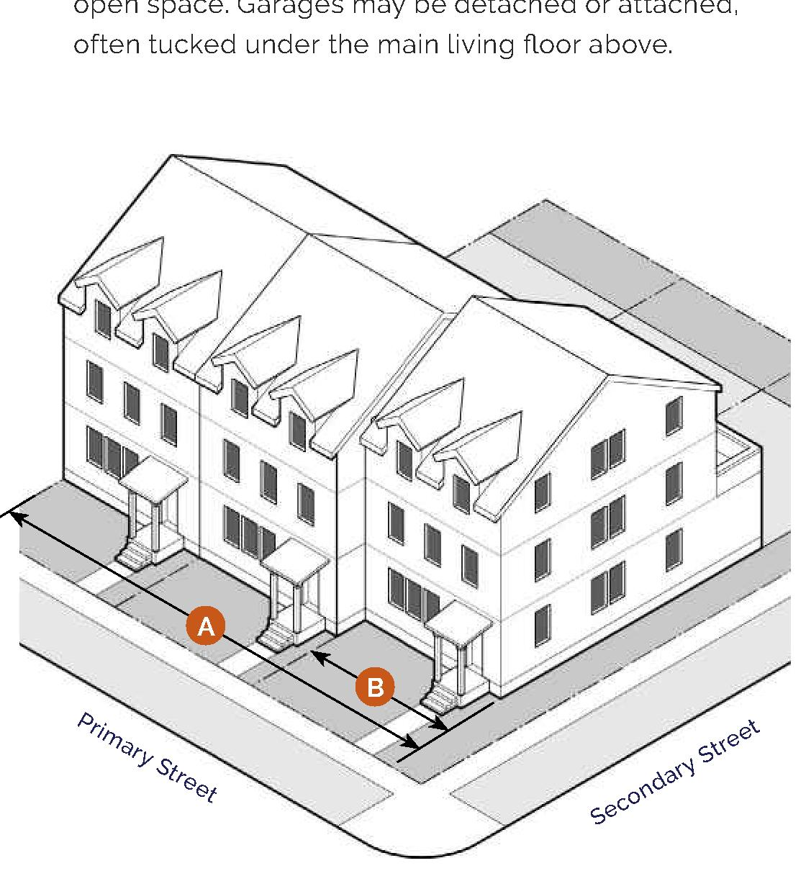
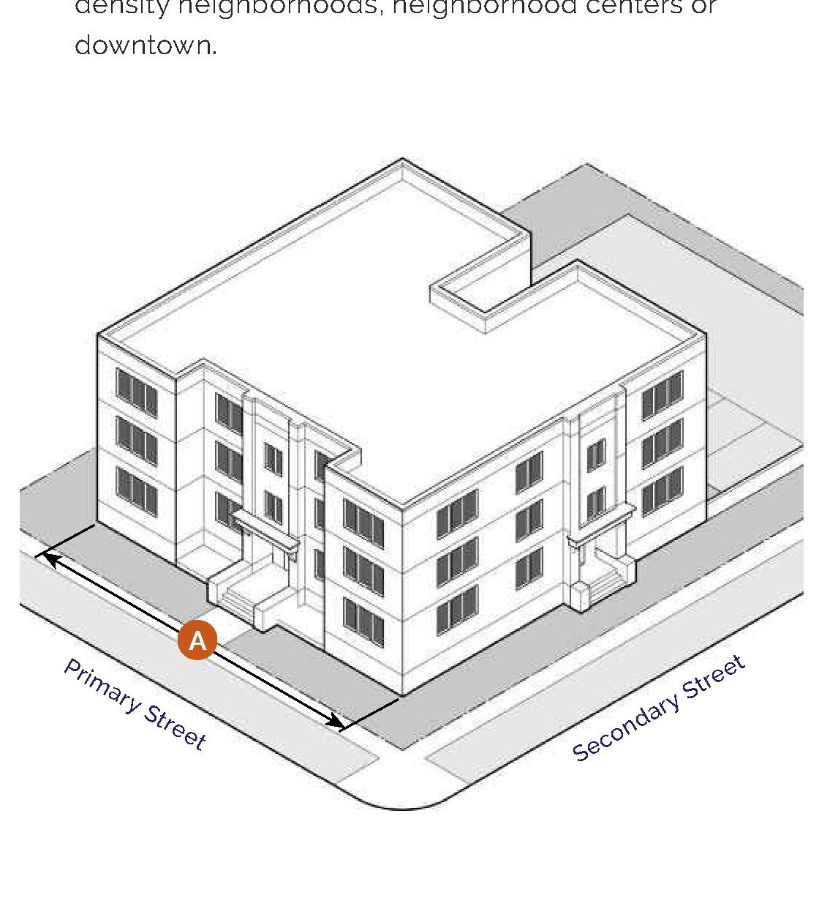
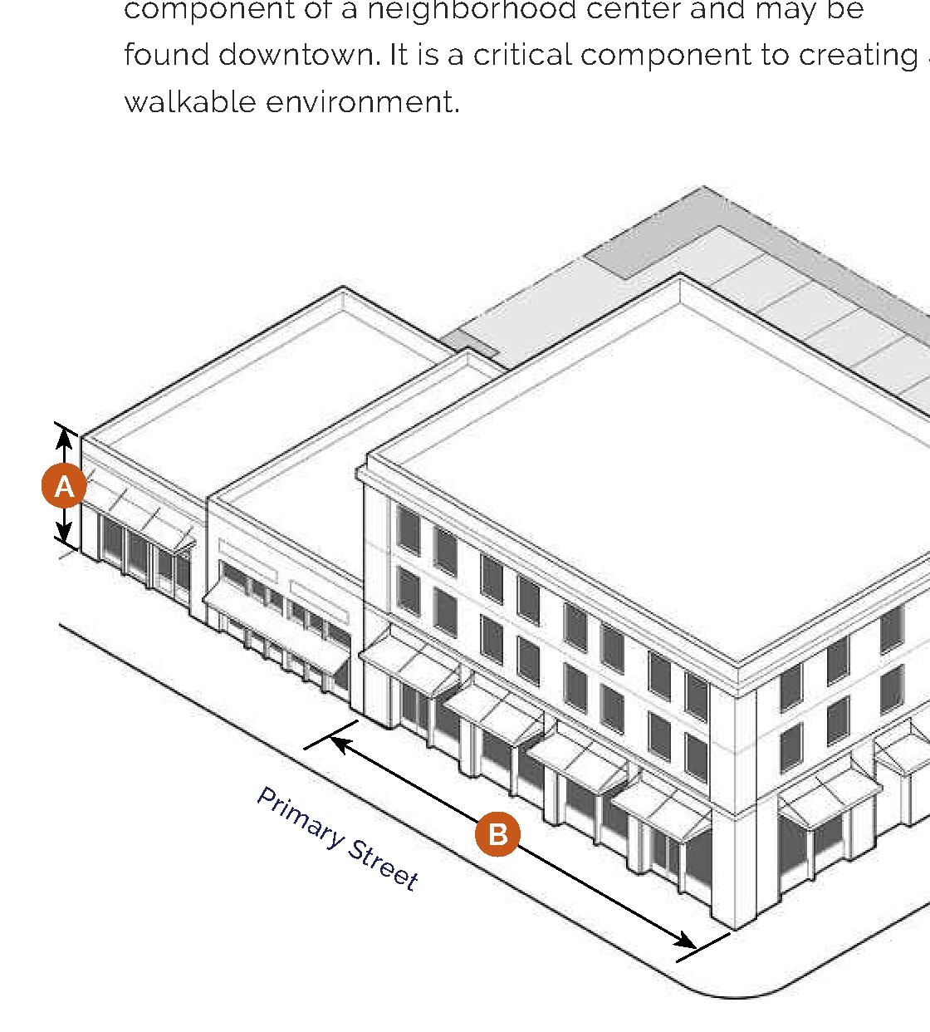
City of South Bend | Zoning Ordinance and FBC
Sec
5-C

Slide 23
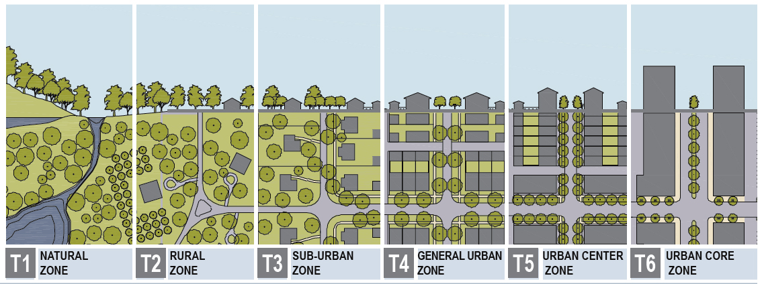
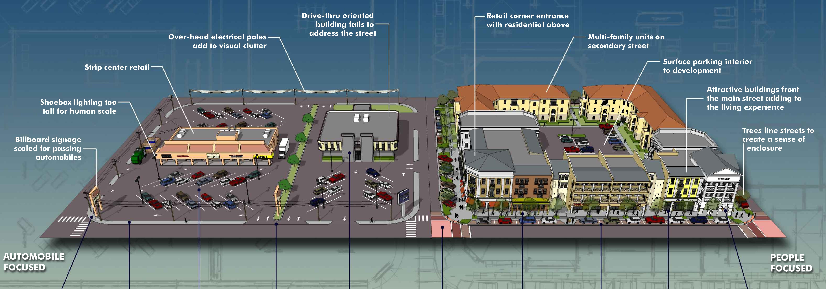
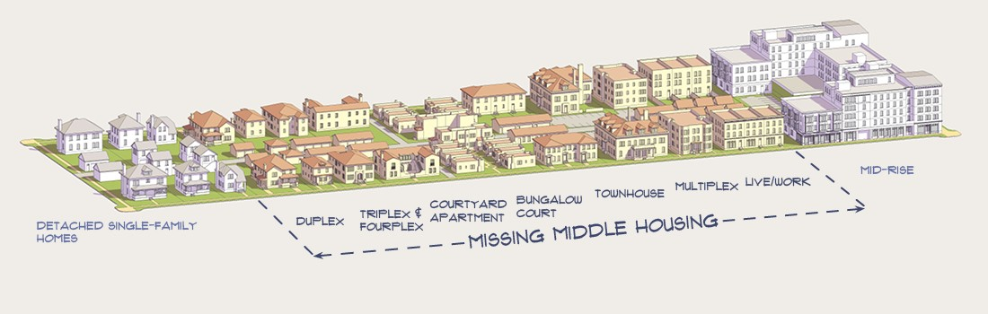
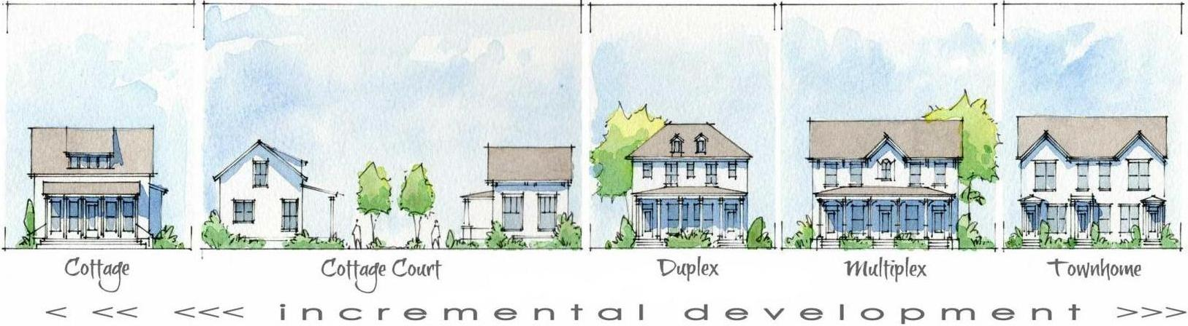
National Trends | Examples
Additional exhibits are provided to convey contemporary and modern trends in the fields of urban and town planning. They include the Rural-to-Urban Transect by DPZ CoDesign (Duany Plater-Zybert); a Town Maker’s Guide to Healthy Building Placement by the Walkable and Livable Communities Institute; a Missing Middle Housing diagram by Opticos Design Group; and guide to incremental development by Thompson Placemaking and on behalf of the Incremental Development Alliance. Interested readers are encouraged to browse these reference materials and research additional information online.
Sec
5-D

Slide 24

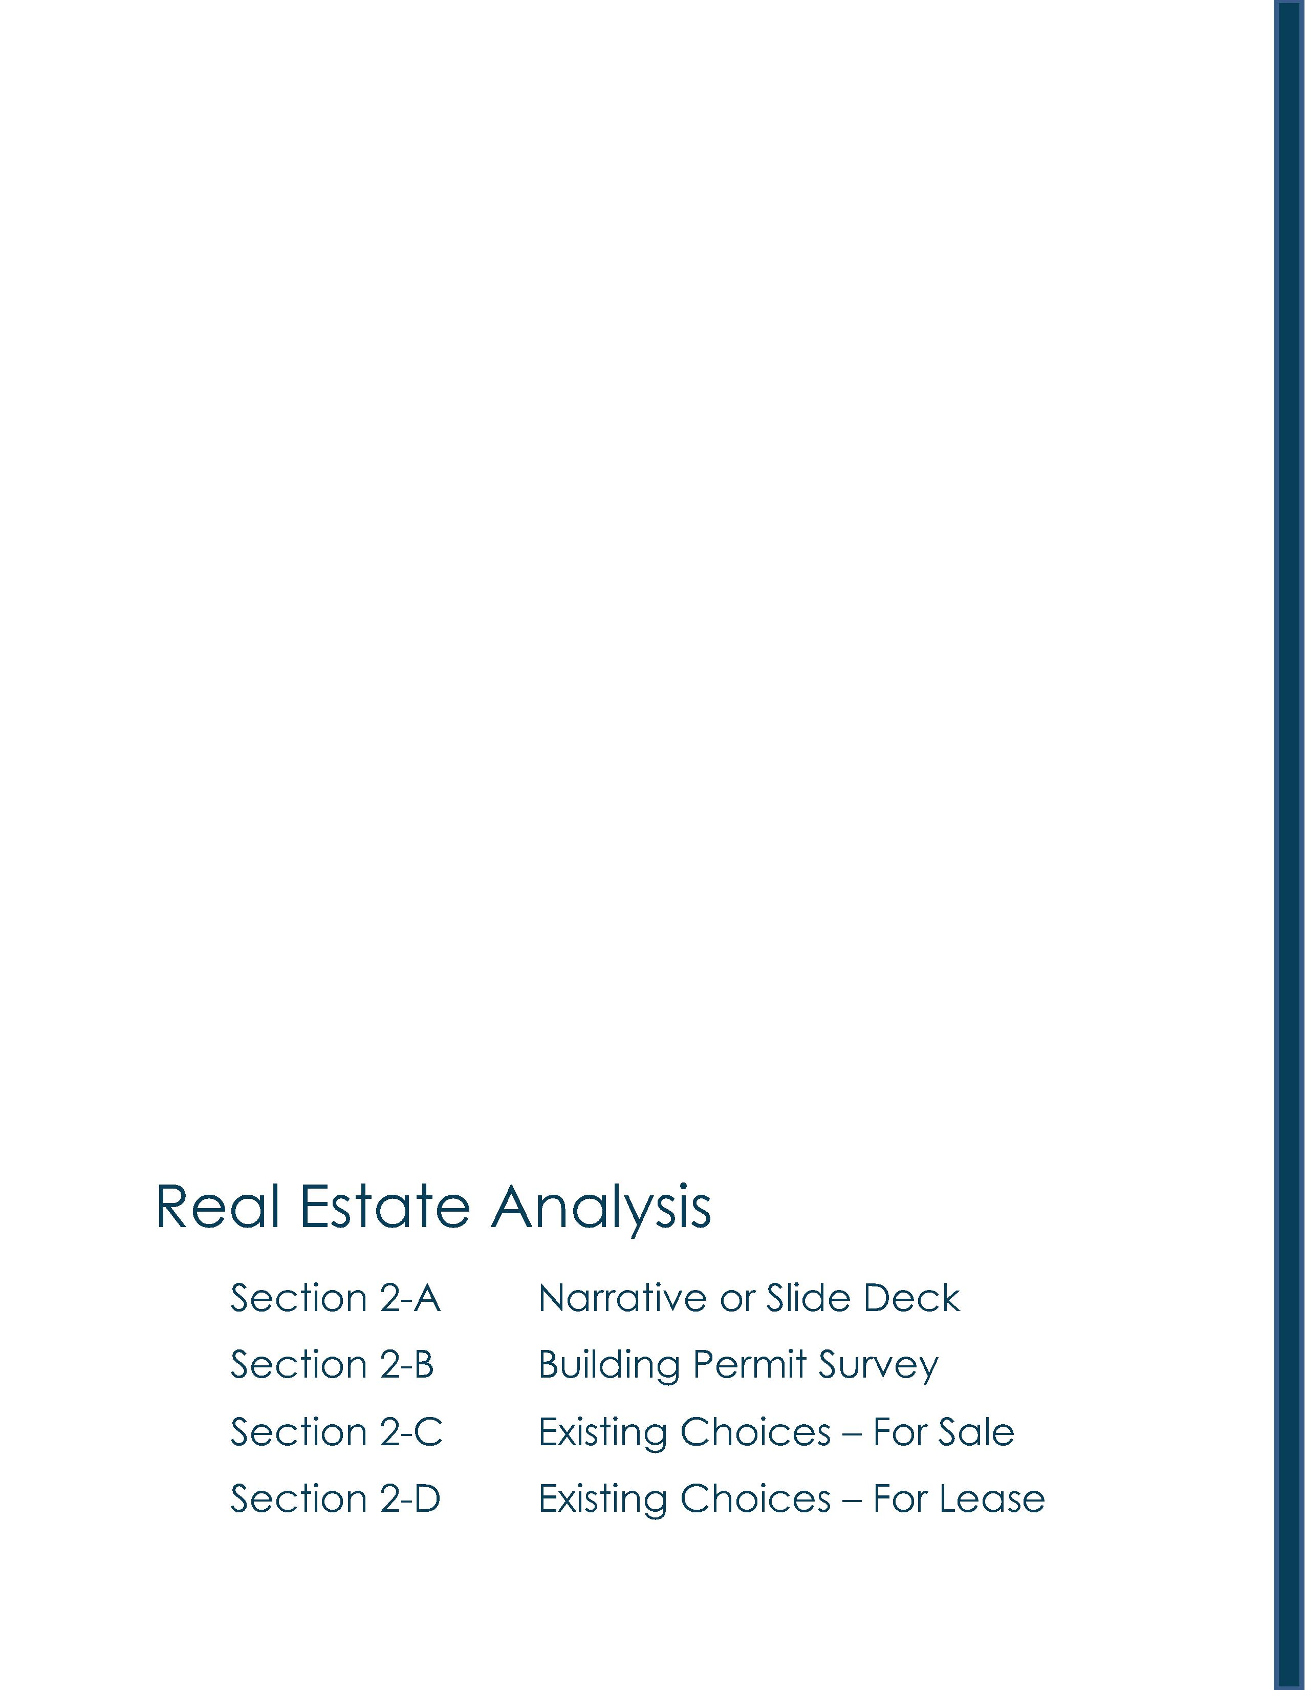
Van Buren County | Real Estate Analysis

Slide 25
Van Buren County | Acknowledgements
Van Buren County Administration
Lisa Ransler, Community Services Director
Van Buren County Administration
219 E Paw Paw Street, Ste 302
Paw Paw, MI 49079
phone | 269-657-8200 x1073
email | ranslerl@vanburencountymi.gov
Market One Van Buren and Cass Counties
Economic & Community Development
Zachary Morris, Executive Director
32849 Red Arrow Hwy, Ste 100
Paw Paw, MI 49079
phone | (269) 519-6142
email | Morrisz@marketvanburen.org
Consultant
LandUseUSA | Urban Strategies
Sharon M. Woods, CNUa
President
Phone | (517) 290-5531
email | sharonwoods@landuseusa.com

Slide 26
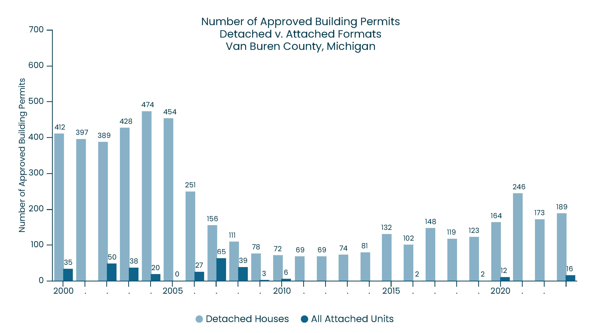
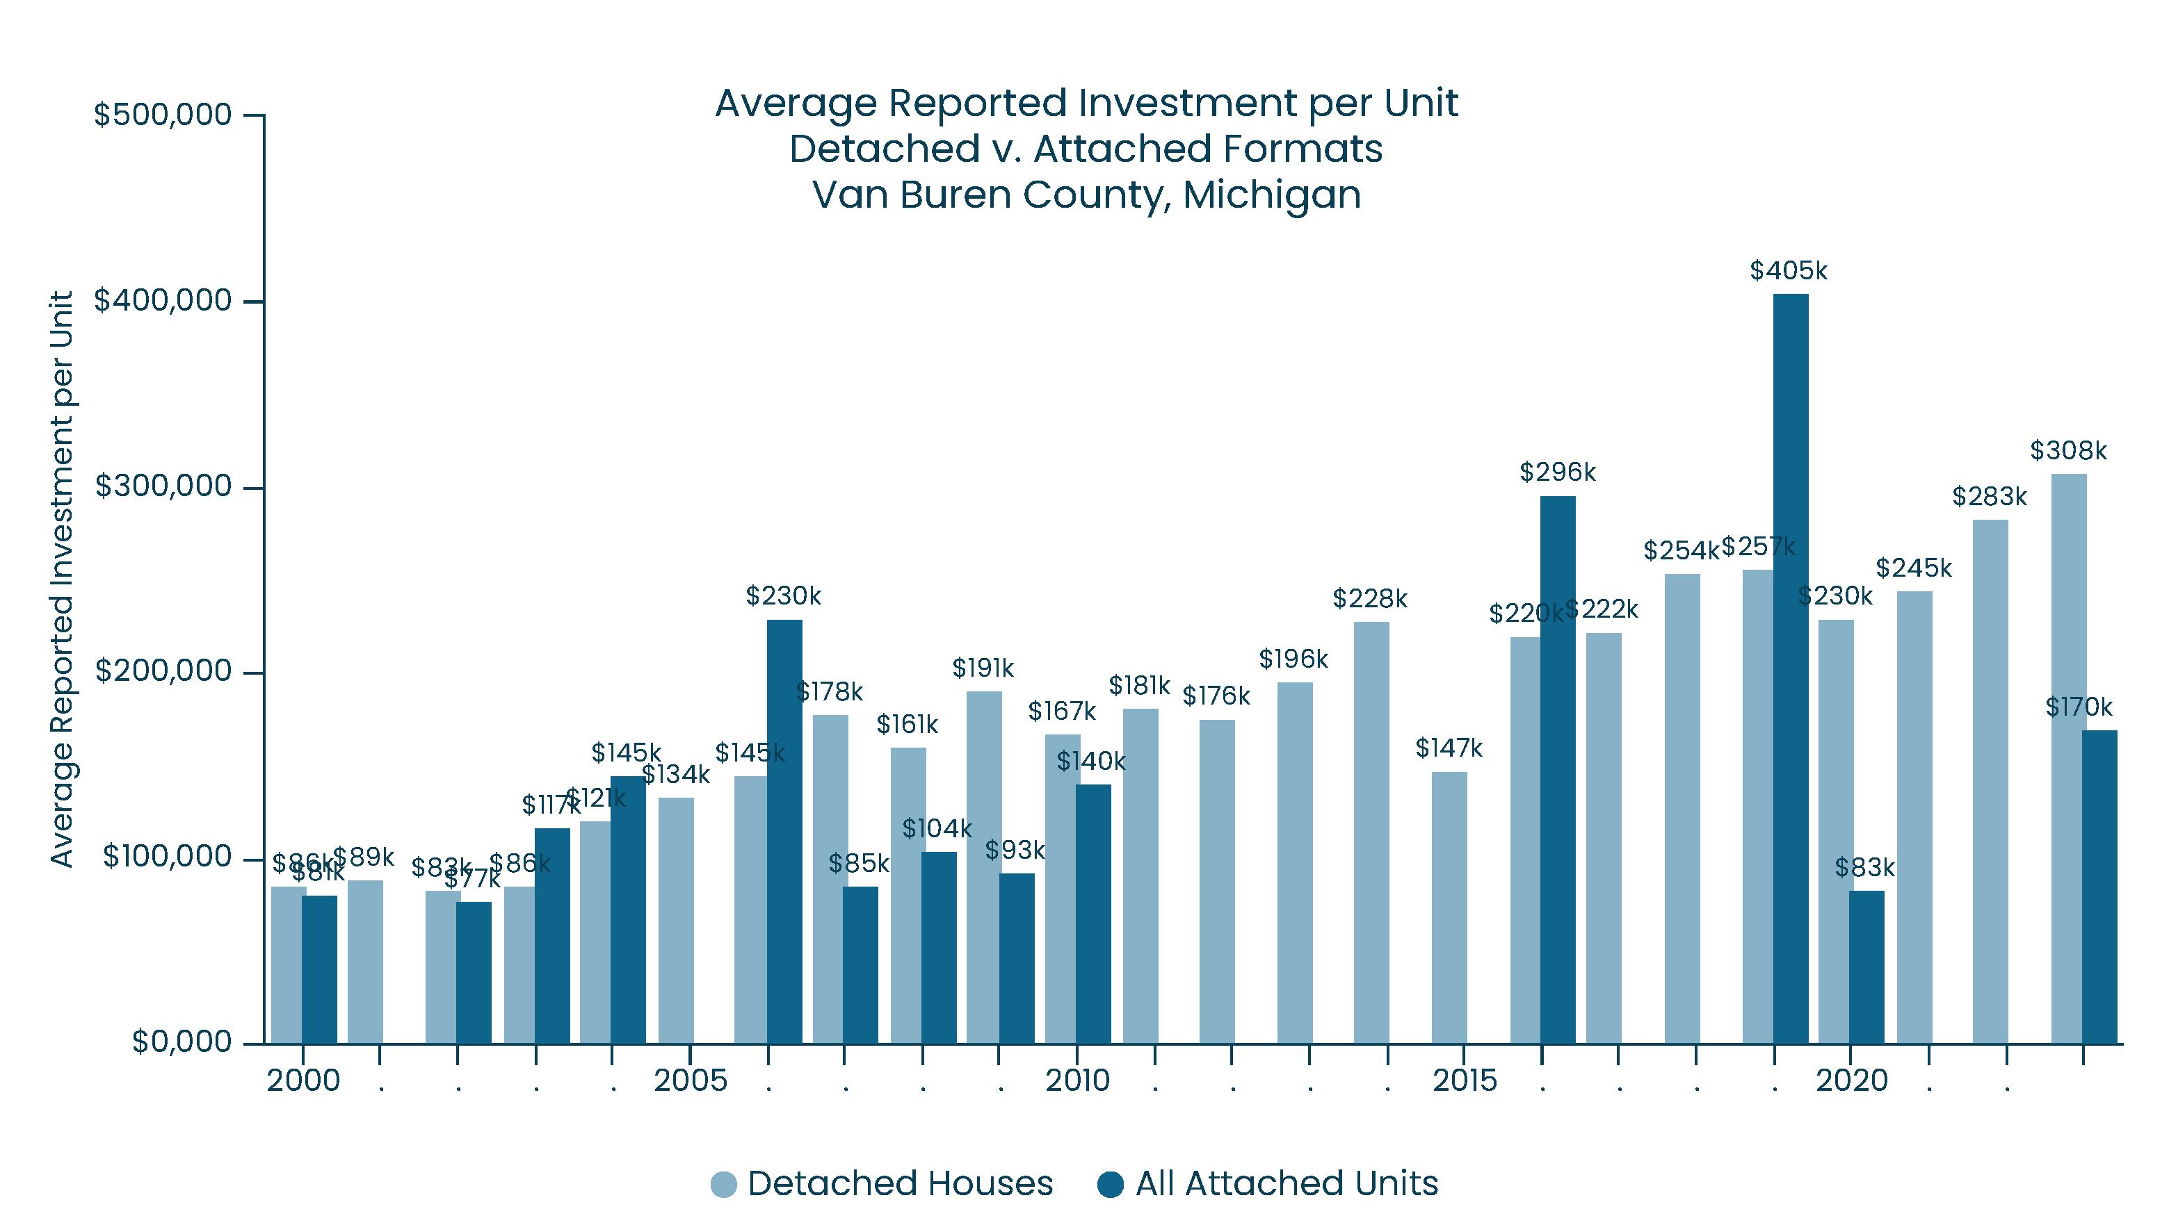
Van Buren County | Building Permit Survey
Data from the U.S. Census Building Permit Survey shows a sharp decline in approved building permit activity during the Great Recession, followed by some slow recovery that commenced in 2015.
It is unlikely that building permit will ever return to pre-recessionary levels, because lending practices now are more closely regulated by federal agencies. Also, many developers and contractors left the industry during the Great Recession. Labor shortages also were exacerbated during the housing crises that followed the Covid-19 health pandemic of 2020-2022.
In general, the reported average investment per attached unit tends to be half that of detached houses. For example, in 2023 the reported average investment into attached units was roughly $170,000, whereas the average investment in detached houses was about $308,000.
This information reinforces the need for new-build housing activity in Van Buren County, and the possible cost savings that could be realized by building attached units instead of supersized houses.
Sec
2-B

Slide 27
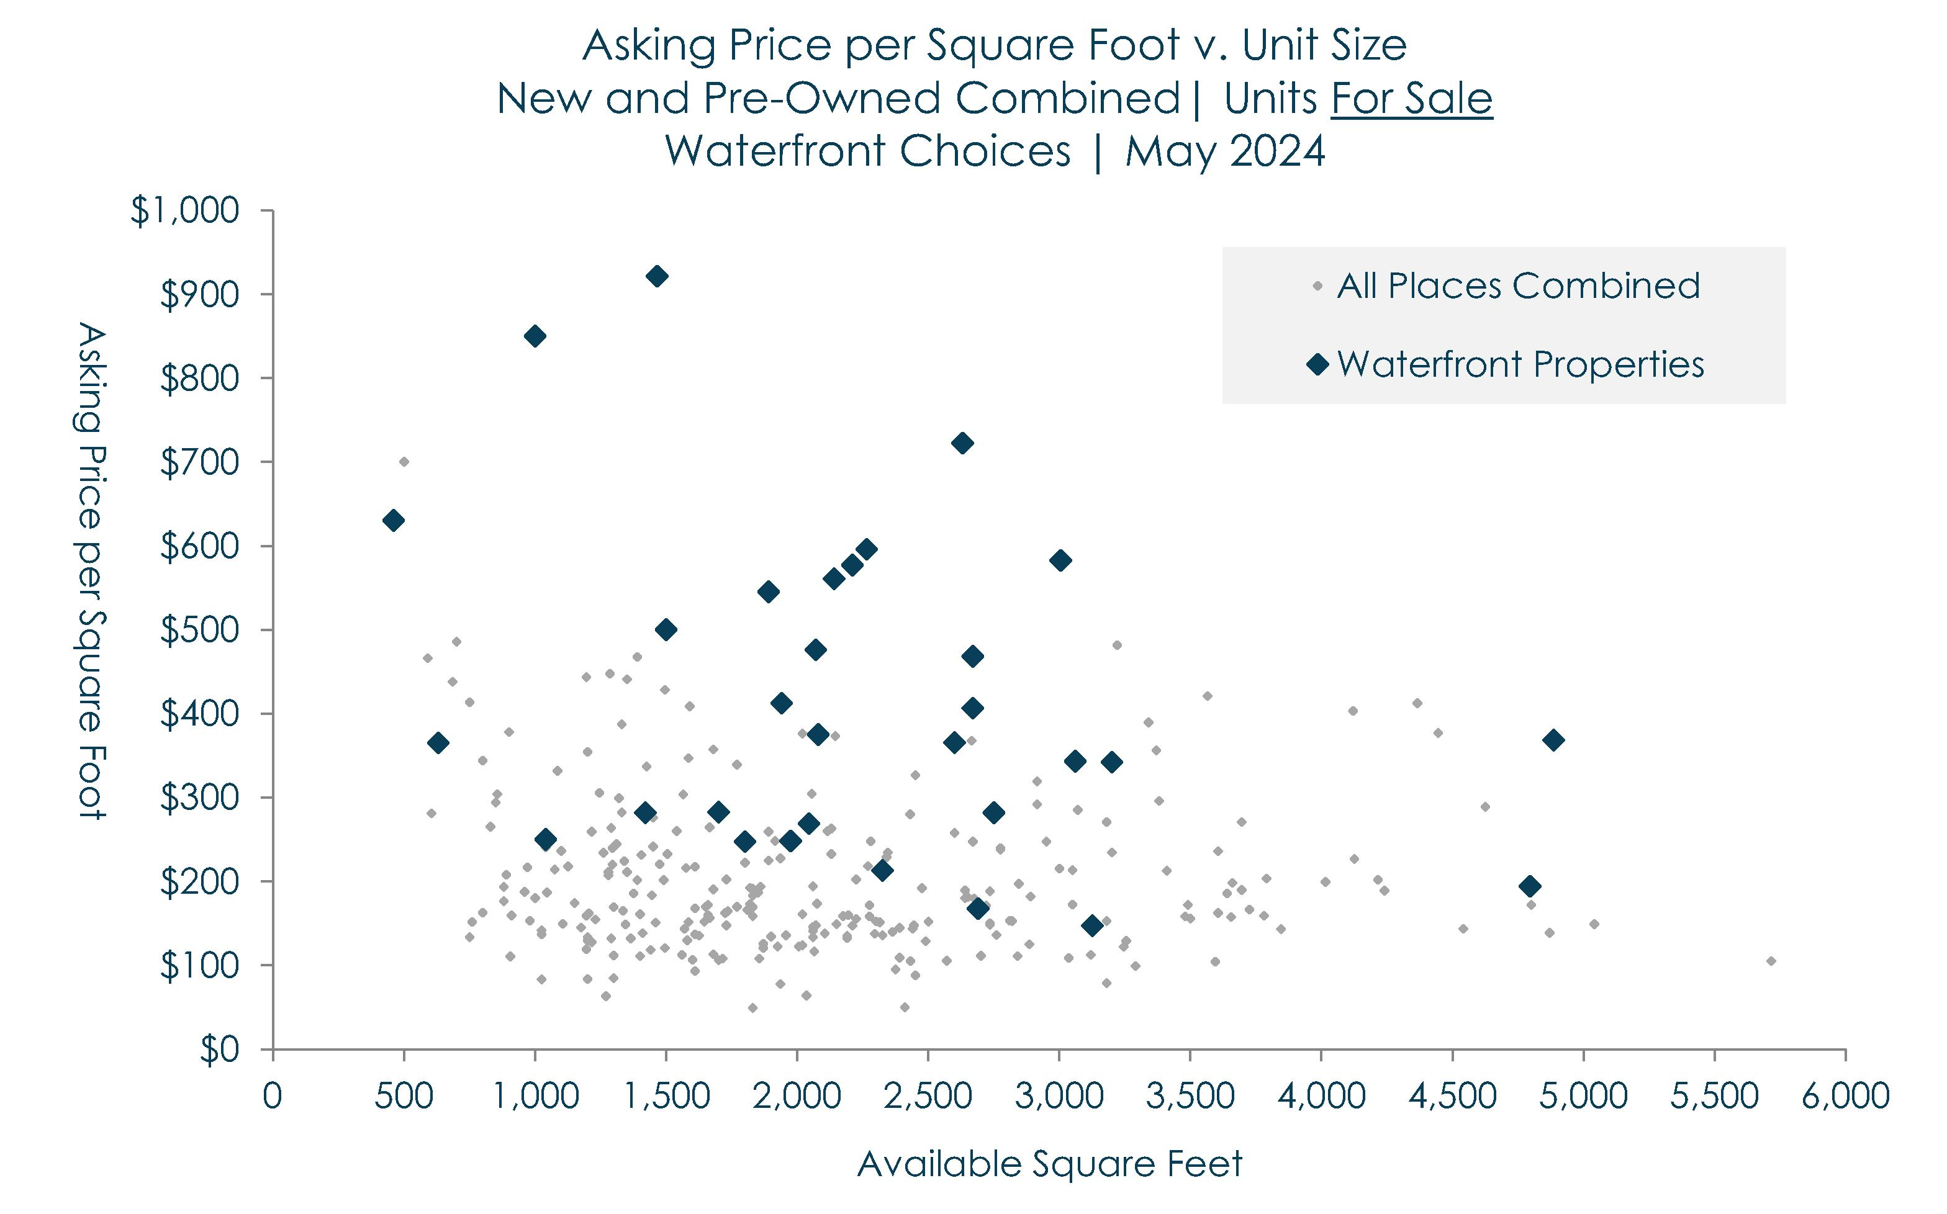
Van Buren Co | For-Sale Housing Choices
To begin, an inventory of available for-sale units in May 2024 is used to demonstrate the magnitude of price premiums for waterfront properties. In general, some waterfront choices (especially newer choices on Lake Michigan) could have prices that exceed $500 per square foot. In comparison, pre-owned units and those on inland lakes are more likely to have prices below $300 per square foot.
Among all available for-sale choices throughout Van Buren County, smaller units that are NOT on the waterfront tend to have prices that peak at $500 per square foot. In comparison, larger units have prices that peak at about $300 per square foot. In general, newer units will have significantly higher prices.
Developers often are motivated to supersize new-build houses in an effort to appeal to families with two wage earners. However, smaller households (i.e., with one wage earner) tend to have higher movership rates. Therefore, smaller units targeted at those households tend to have faster absorption rates.
Regardless of the geography, smaller units tend to have higher prices per square foot than larger units. This suggests that, rather than building 4 large houses on a parcel, developers should build 6 smaller houses. The added costs of building additional kitchens and bathrooms could be offset by higher prices per square foot.
Sec
2-C

Slide 28
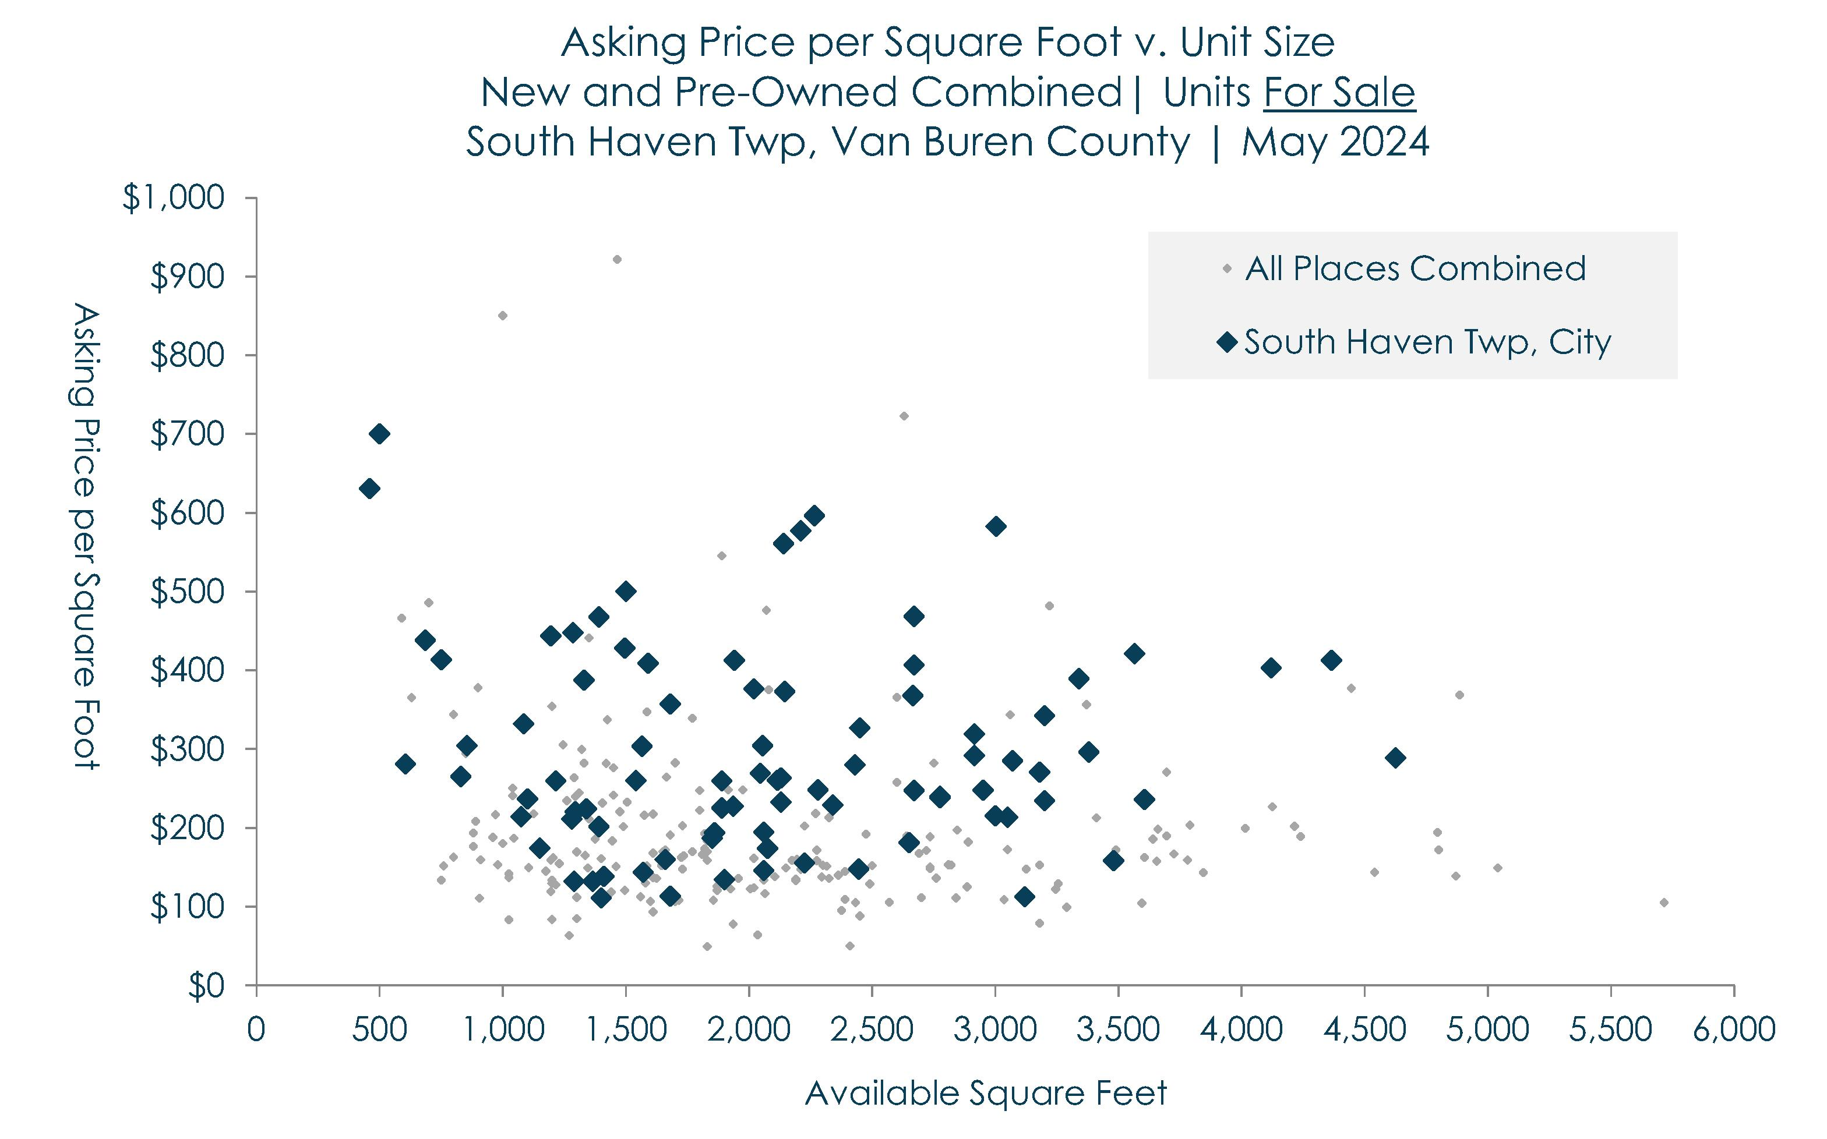
Van Buren Co | For-Sale Housing Choices
In the Real Estate Analysis, a few of the local places like South Haven, Covert Township, and the Villages of Paw and Mattawan are highlighted in this slide deck, along with county-wide results. Stakeholders are encouraged to use the next few slides as a guide to the study results for other places in Van Buren County.
Based on results, for-sale choices in South Haven Township and the City of South Haven vary considerably. Even so, there is a general relationship between the unit size and asking price per square foot, with smaller units generally be more efficient.
This slide helps set the stage and provides some context for the next slide, which highlights the results for Covert and Hartford Townships.
Sec
2-C

Slide 29
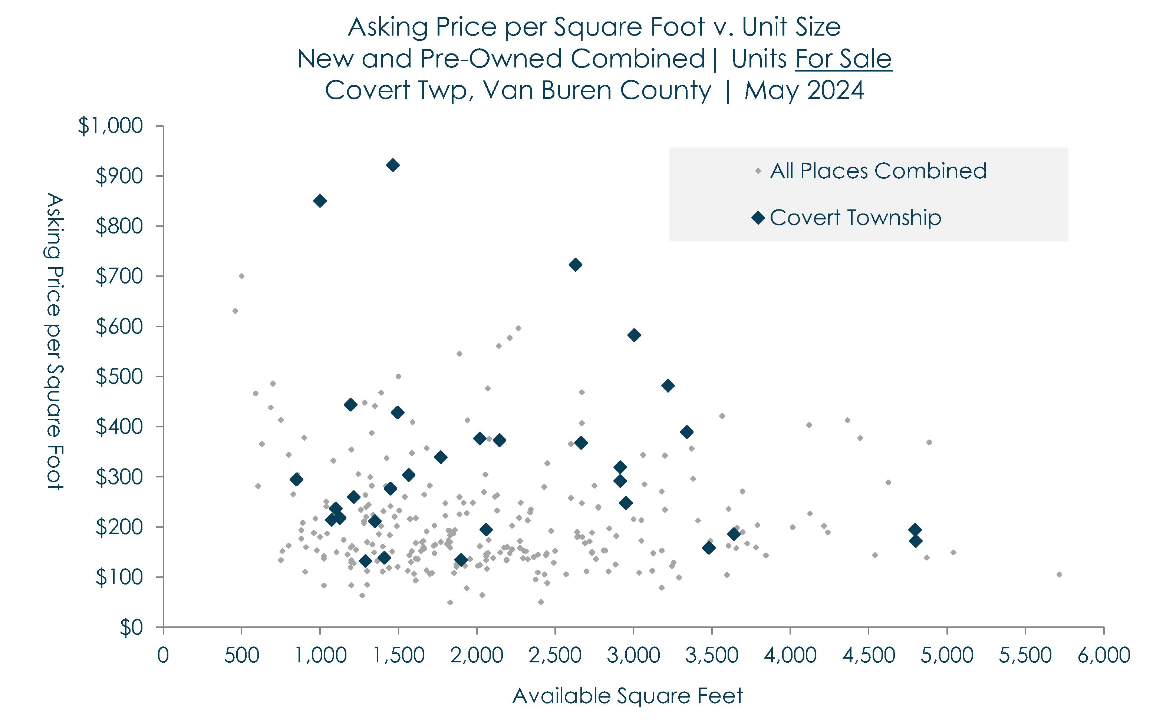
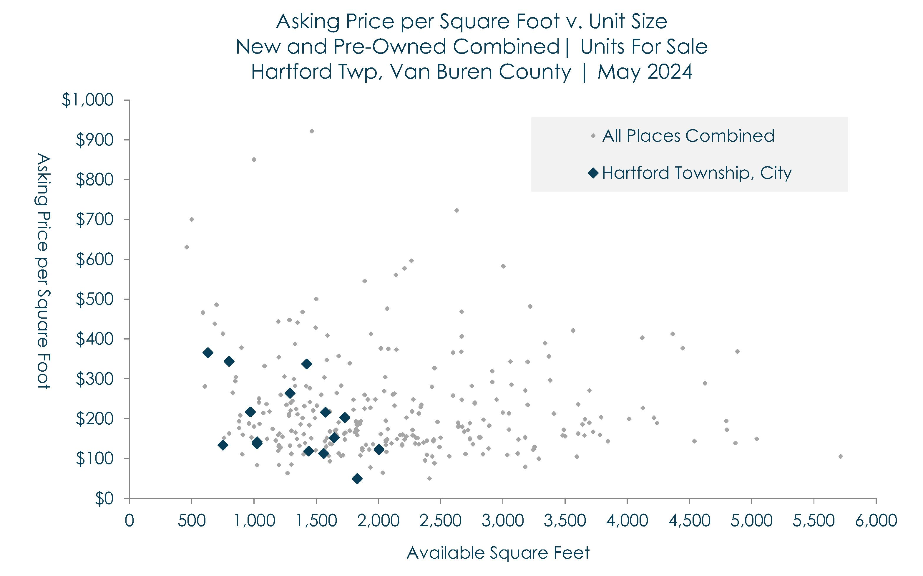
Van Buren Co | For-Sale Housing Choices
Compared to South Haven Township, there are far fewer for-sale choices available in Covert and Hartford Townships (including the City of Hartford).
Compared to Hartford Township, Covert Township is more likely to have a few larger houses available for-sale, and also is more likely to have waterfront choices.
The prices in Hartford Township seem suppressed relative to choices throughout the county overall. At the time of this study, there were only three choices with prices above $300 per square foot.
Also, about one-third of the for-sale choices in Covert Township have more than 2,500 square feet of space. In comparison, the largest choice available in Hartford Township is about 2,000 square feet.
Note: These two places are highlighted to provide a interesting comparison between two unique places in Van Buren County. Readers are encouraged to explore the complete Real Estate Analysis to find additional scatter plots for other places in the county.
Sec
2-C

Slide 30
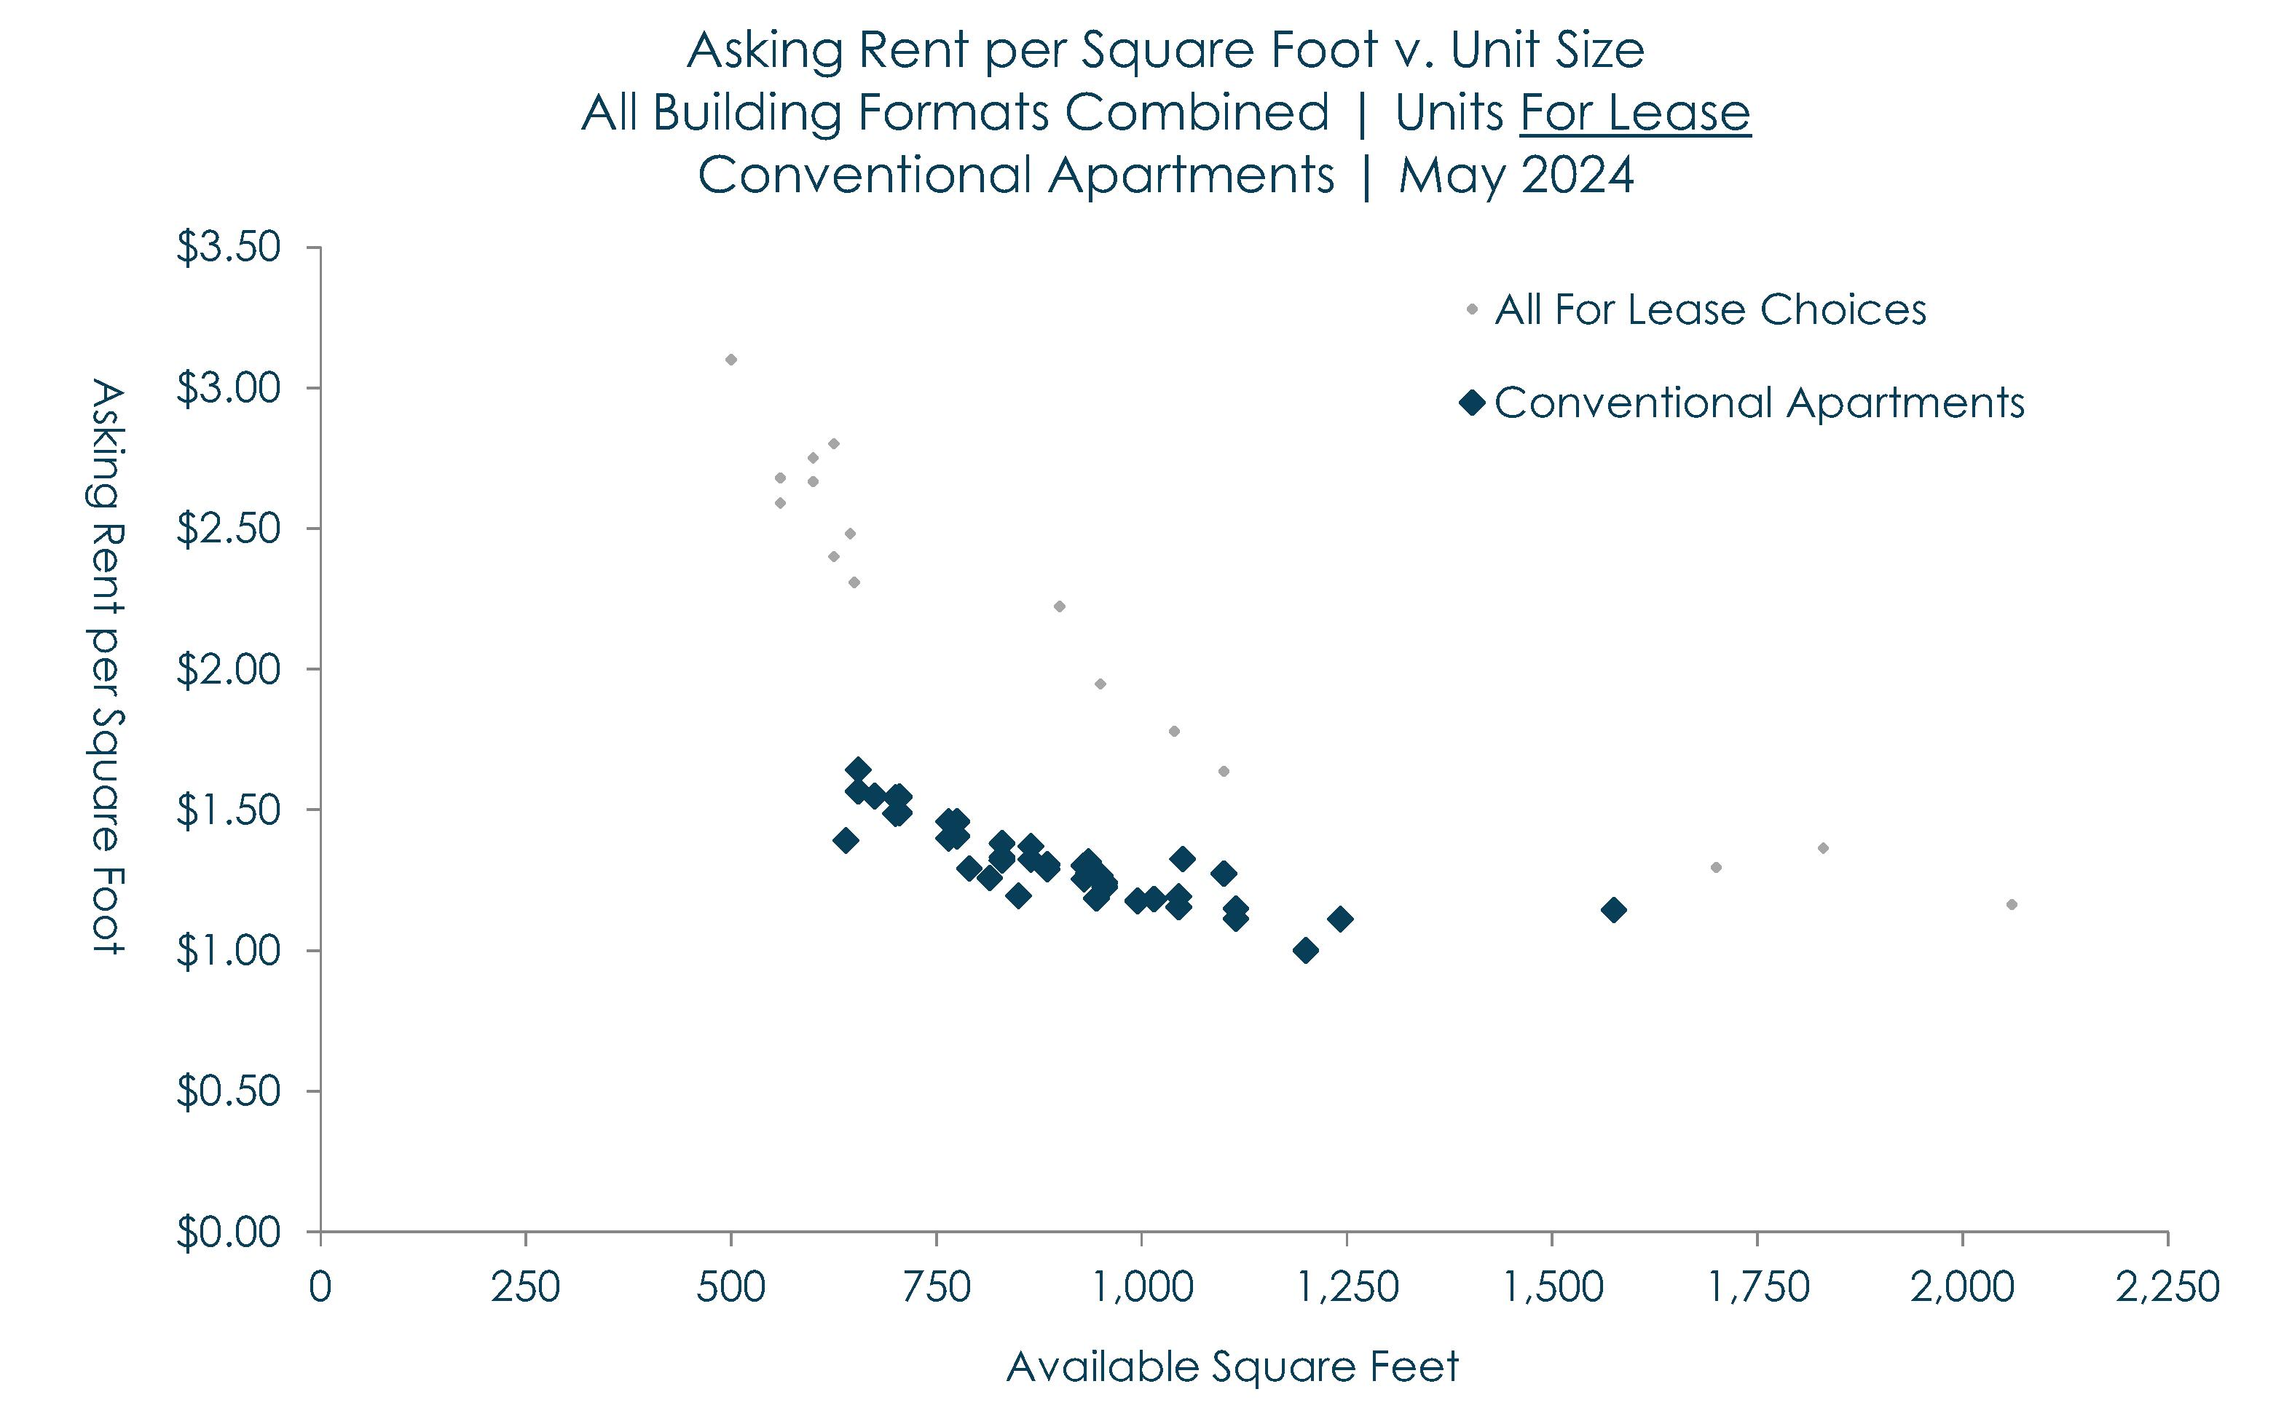
Van Buren Co | For-Lease Housing Choices
The prior slides compared the asking prices per square foot among for-sale choices throughout Van Buren County. This slide shifts the focus to for-lease units, and prices based on monthly contract (cash or net) rents.
To begin, there are far fewer for-lease choices available in Van Buren County when compared to the variety of choices available for-sale (see the prior slides).
Regardless, it is indisputable that conventional apartments have suppressed rents, and only the smallest units are exceeding $150 per square foot.
Again, smaller units tend to have higher prices per square foot than larger units. The largest units among conventional apartments have prices that barely reach $1.25 per square foot – which is low by today’s standard.
Sec
2-C

Slide 31
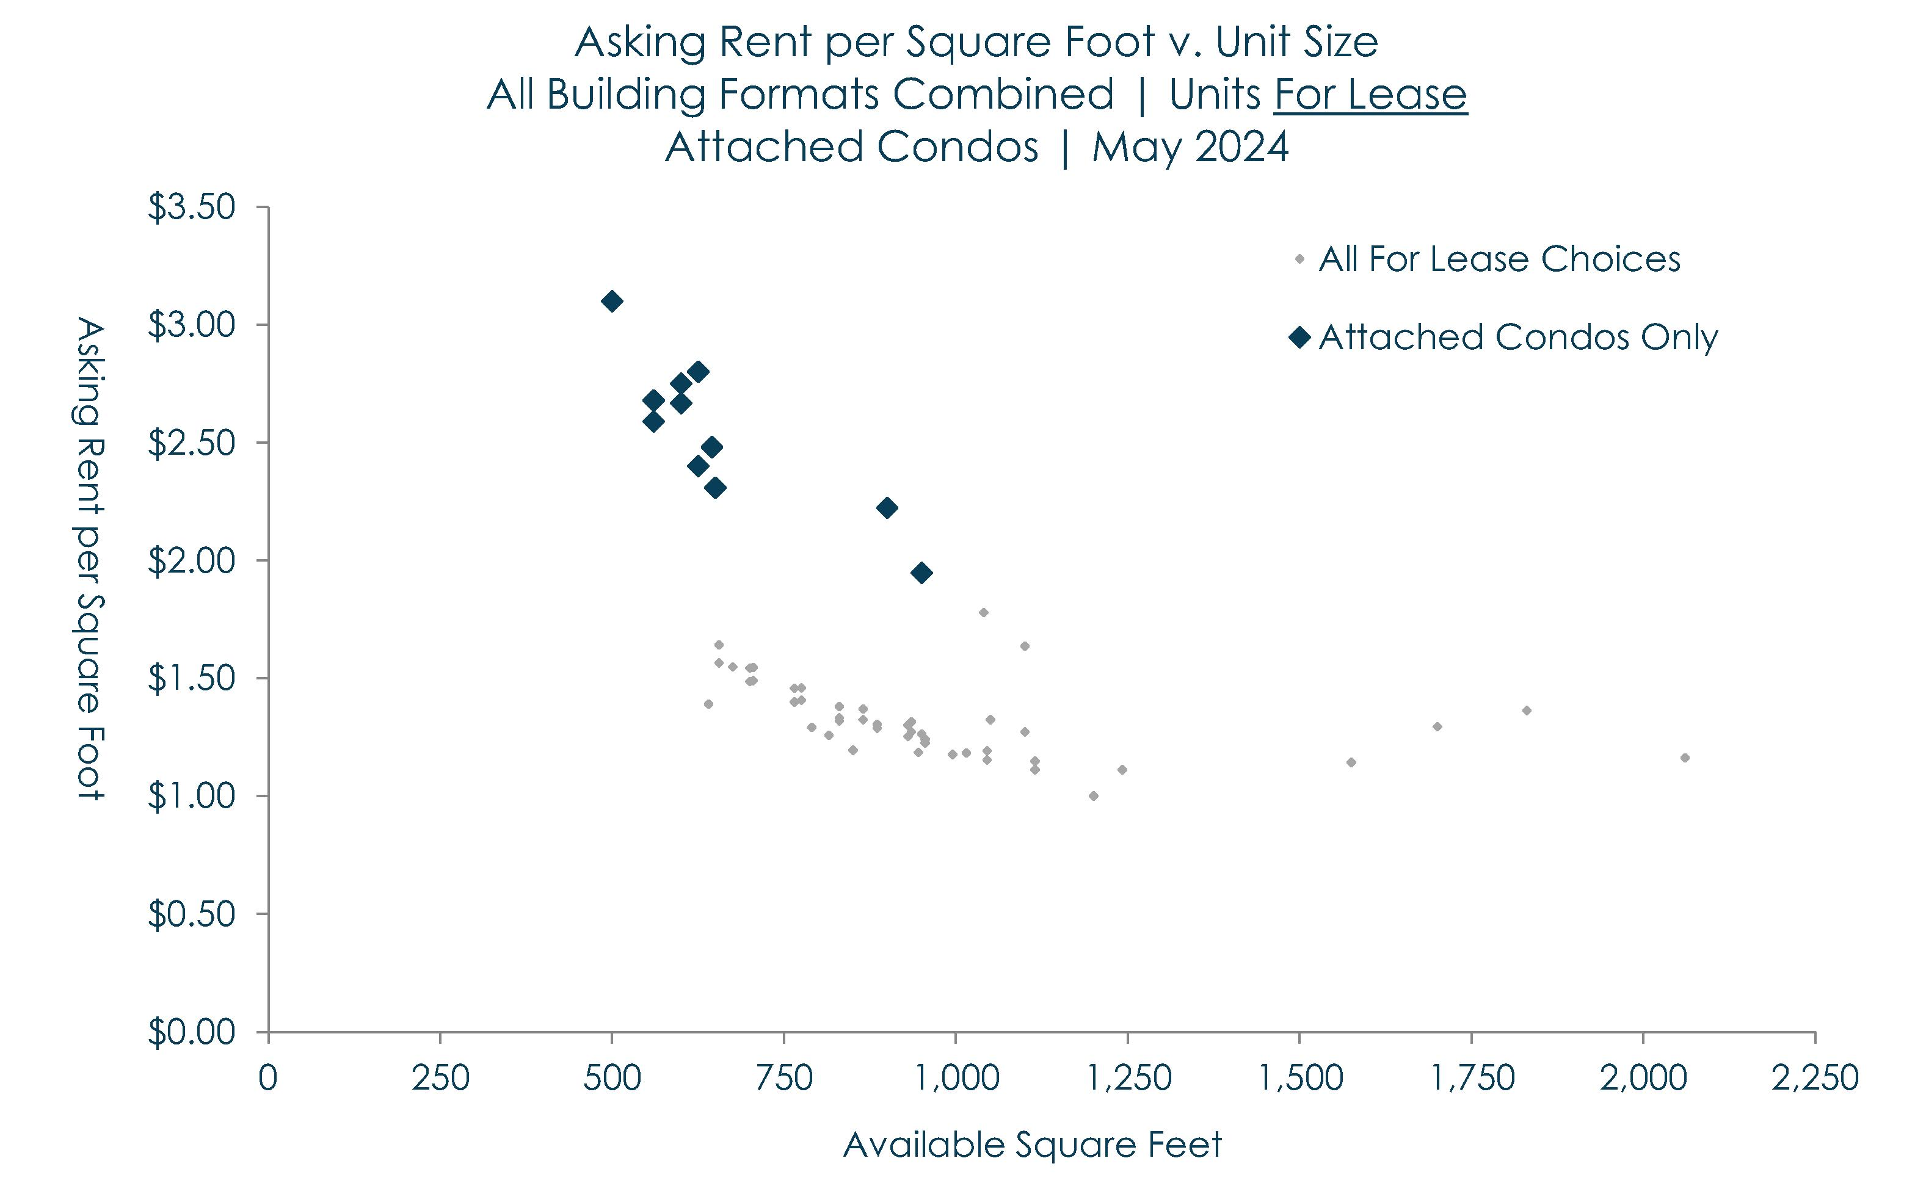
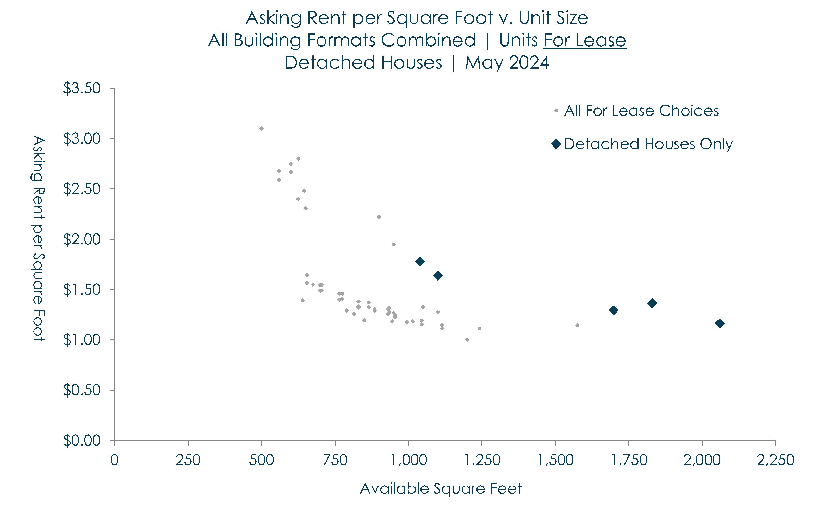
Van Buren Co | For-Lease Housing Choices
The last two slides strive to differentiate between available for-lease choices in Van Buren County that are alternatives to conventional apartments. In general, attached condos have significantly higher rents in the range of $2.25 to $2.75 per square foot. Most of these also are located in South Haven Township (including the City of South Haven), with views, glimpses, and breezes along Lake Michigan.
There also are a few detached houses available for-lease in Van Buren County. However, in May 2024 there were only five (5) choices, and the asking rents were below $2.00 per square foot (and $1.25 per square foot for the largest houses).
In general, these absence of choices and suppressed rents among conventional apartments reinforce the need to build more for-lease choices in Van Buren County. There also is a need to build more Missing Middle Housing formats that are alternatives to conventional apartments and waterfront condos.
Sec
2-C

Slide 32
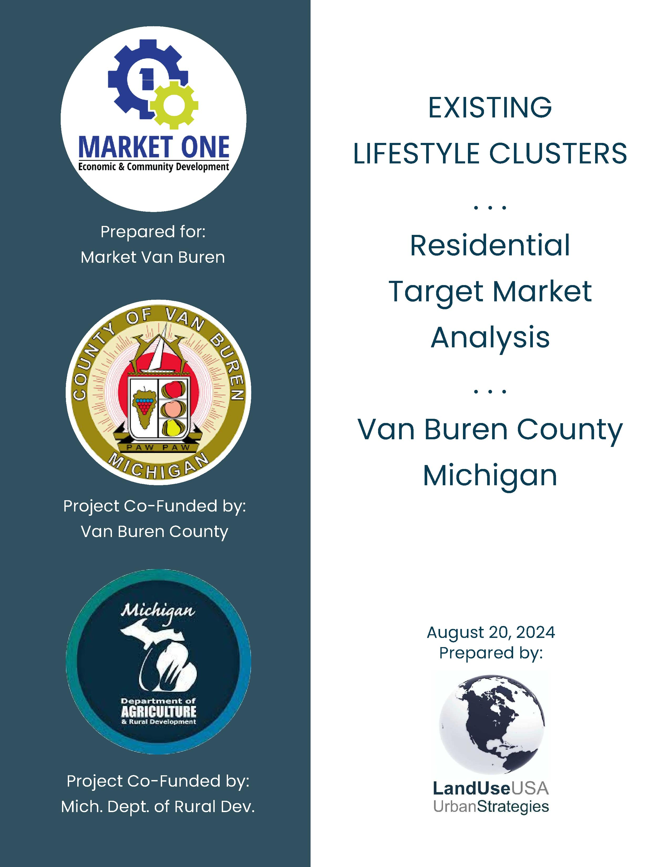
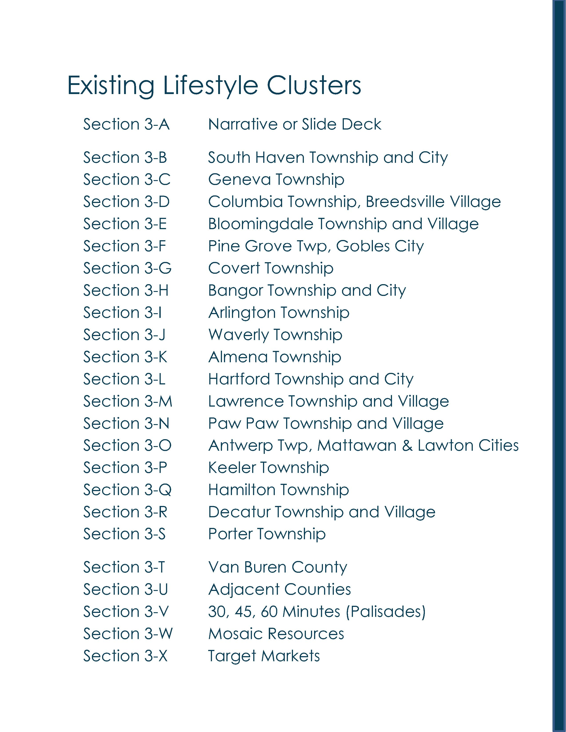
Van Buren County | Existing Lifestyle Clusters

Slide 33
Van Buren County | Acknowledgements
Van Buren County Administration
Lisa Ransler, Community Services Director
Van Buren County Administration
219 E Paw Paw Street, Ste 302
Paw Paw, MI 49079
phone | 269-657-8200 x1073
email | ranslerl@vanburencountymi.gov
Market One Van Buren and Cass Counties
Economic & Community Development
Zachary Morris, Executive Director
32849 Red Arrow Hwy, Ste 100
Paw Paw, MI 49079
phone | (269) 519-6142
email | Morrisz@marketvanburen.org
Consultant
LandUseUSA | Urban Strategies
Sharon M. Woods, CNUa
President
Phone | (517) 290-5531
email | sharonwoods@landuseusa.com

Slide 34
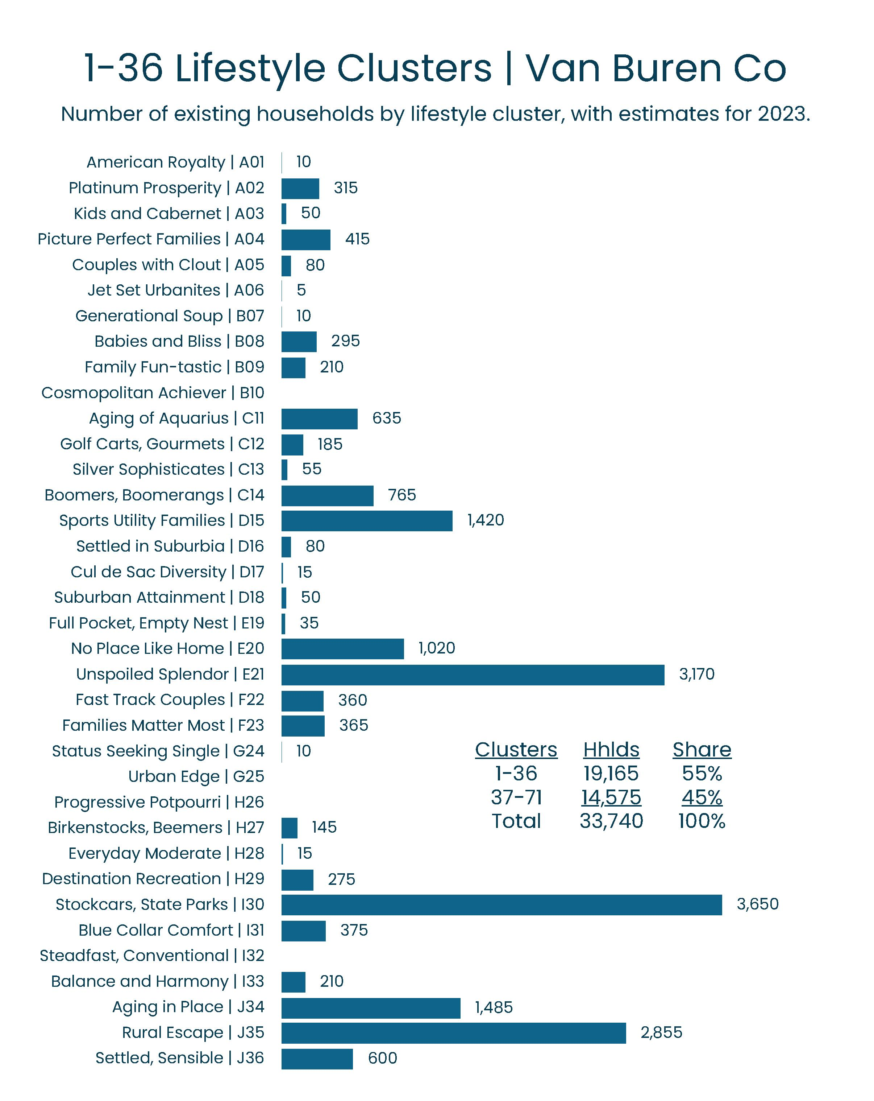
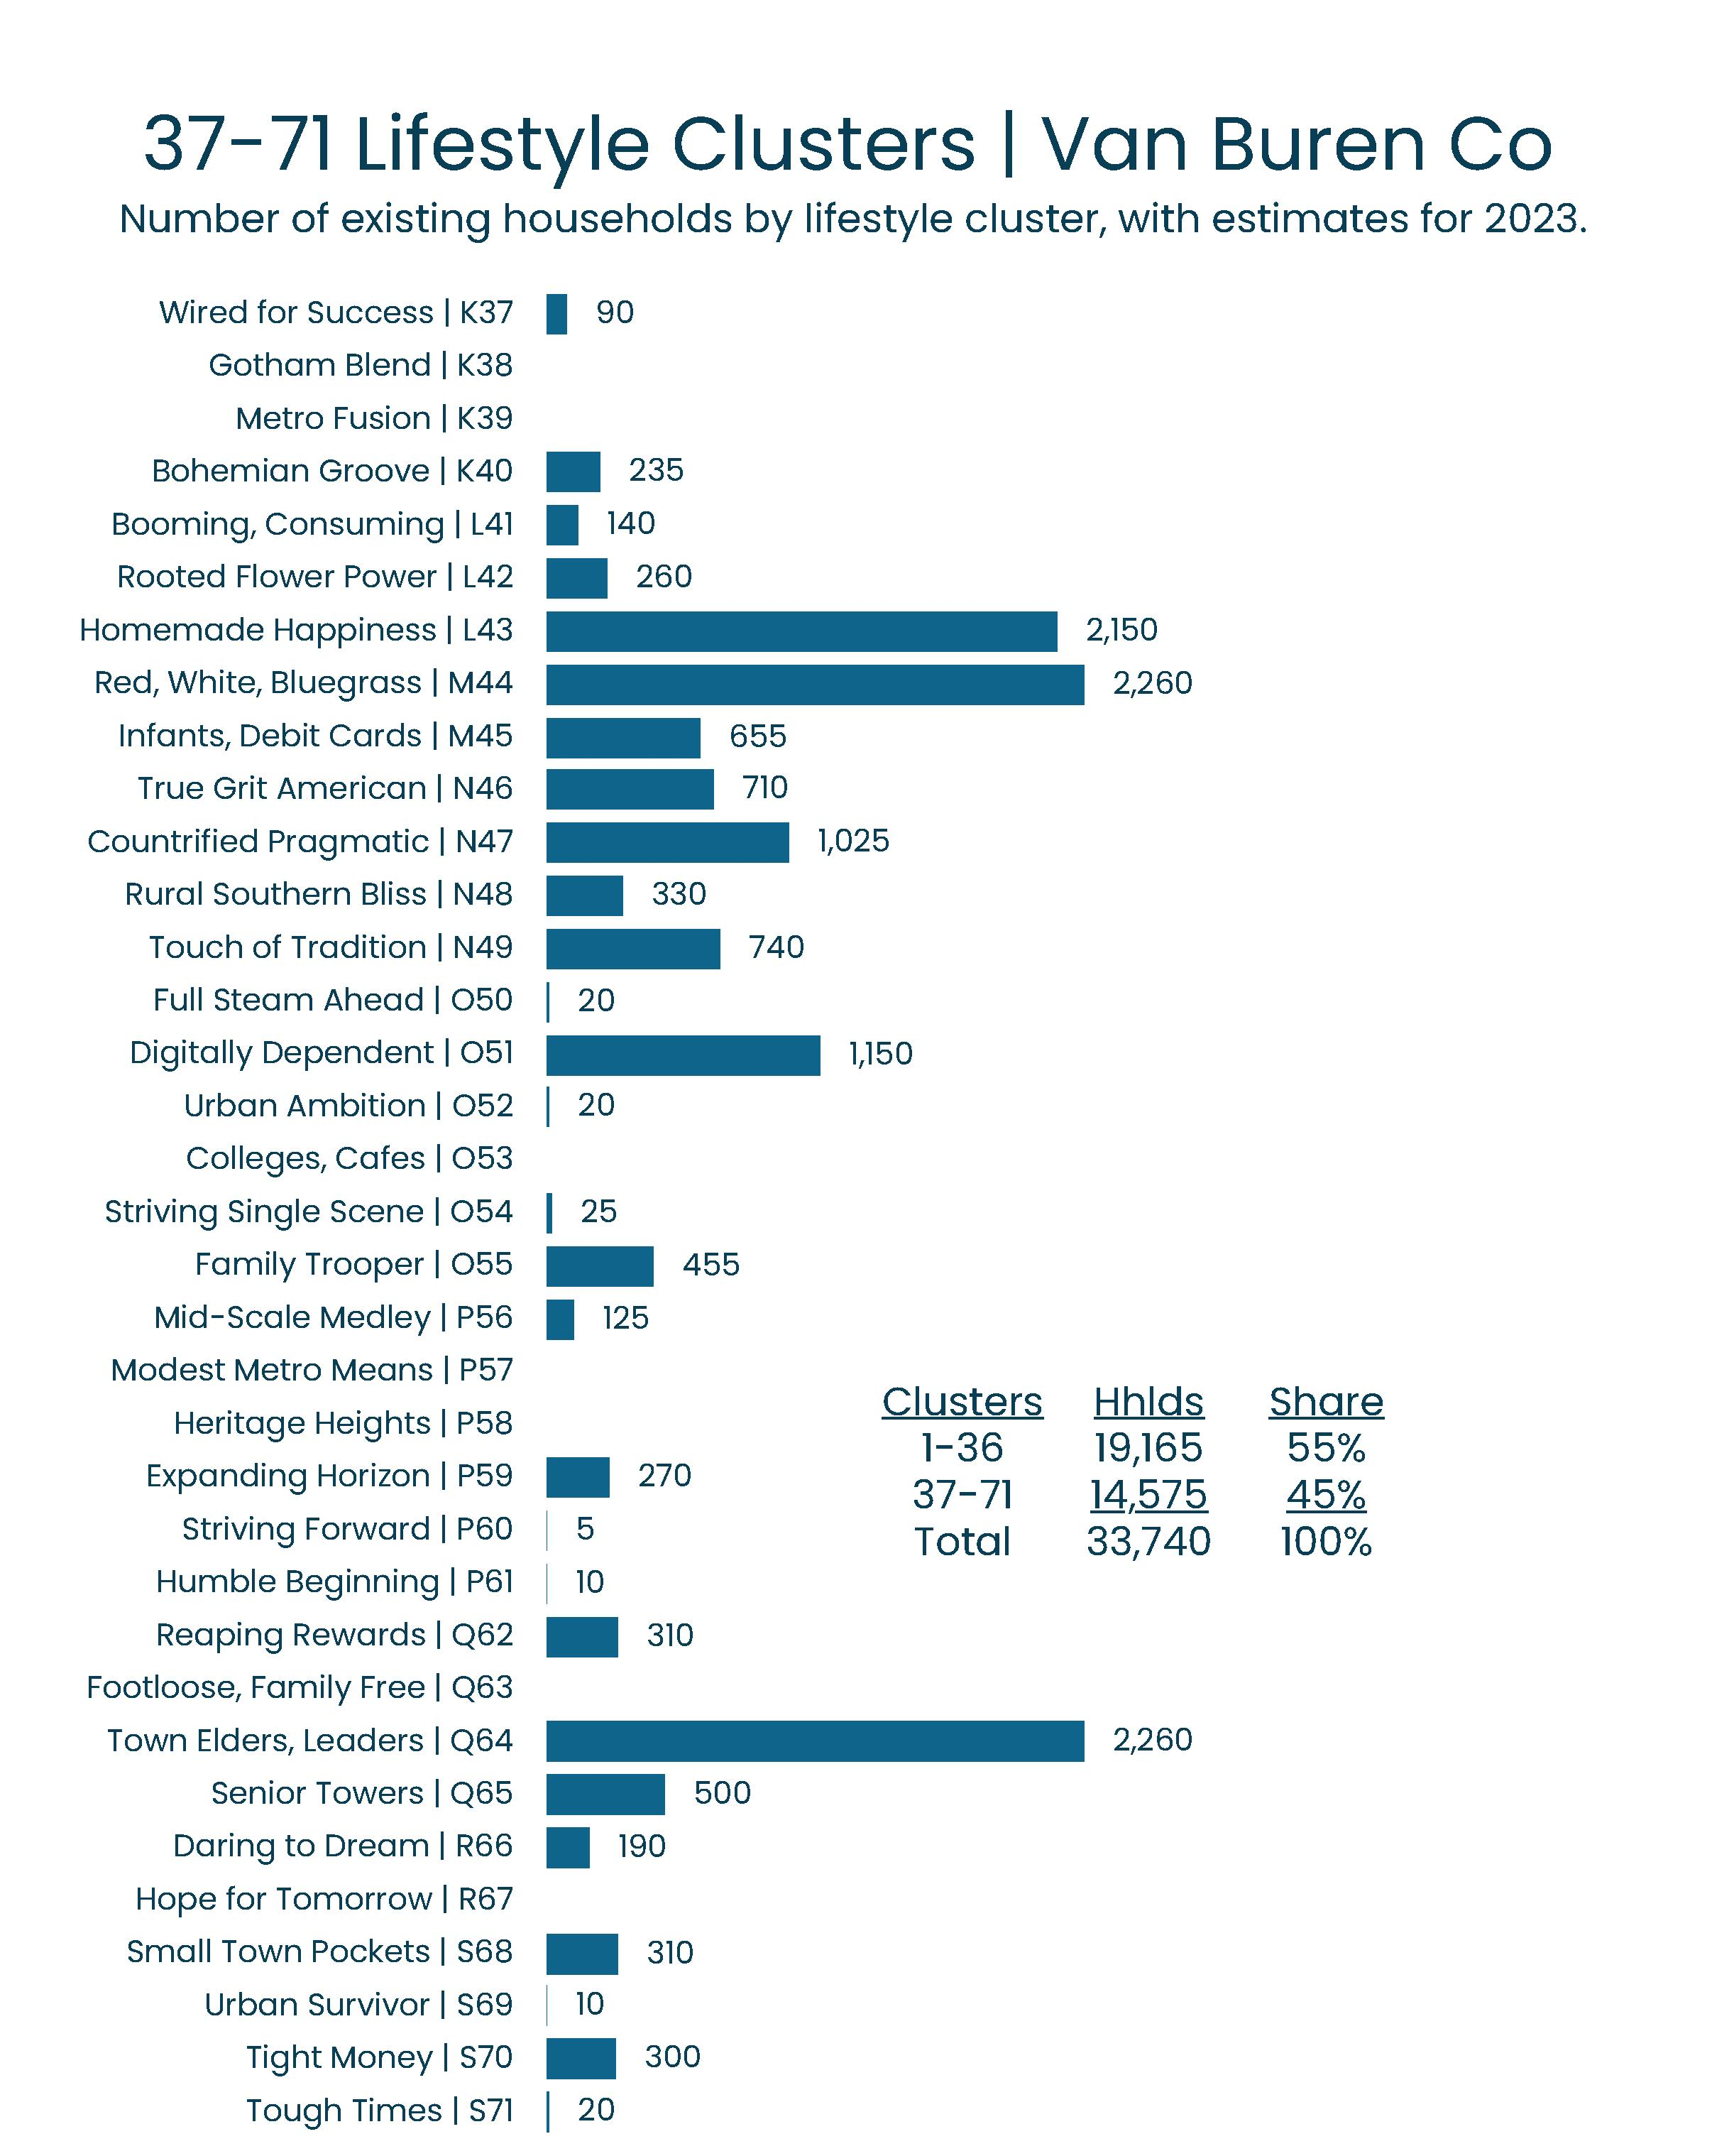
Van Buren Co | 71 Existing Lifestyle Clusters
Histograms are provided to demonstrate the number of existing (2023) households among all 71 lifestyle clusters as defined by Experian Decision Analytics. There are two pages of histograms for Van Buren County, plus tables for each township, city, and village.
The most affluent lifestyle clusters (A01 – J36) are provided on the first page; and the more moderate lifestyle clusters (K37 – S71) on the second page. They generally are organized in order of declining income, with the most affluent being “American Royalty”; and the lowest income being “Tough Times”.
For example, among the relatively affluent lifestyle clusters, Van Buren County currently has 3,650 existing households among the Stockcars and State Parks and 3,170 households among the Unspoiled Splendor lifestyle clusters. There also are 2,855 households among Rural Escape.
Among the households with moderate and market rate incomes, Van Buren County also has 2,260 households that are Red White Bluegrass and 2,150 households that are Homemade Happiness. Some of the county’s lowest income households include the Town Elders and Leaders.
Note: larger exhibits are provided on the next slide.
Sec
3-B

Slide 35
Van Buren Co | 71 Existing Lifestyle Clusters
Sec
3-B

Slide 36
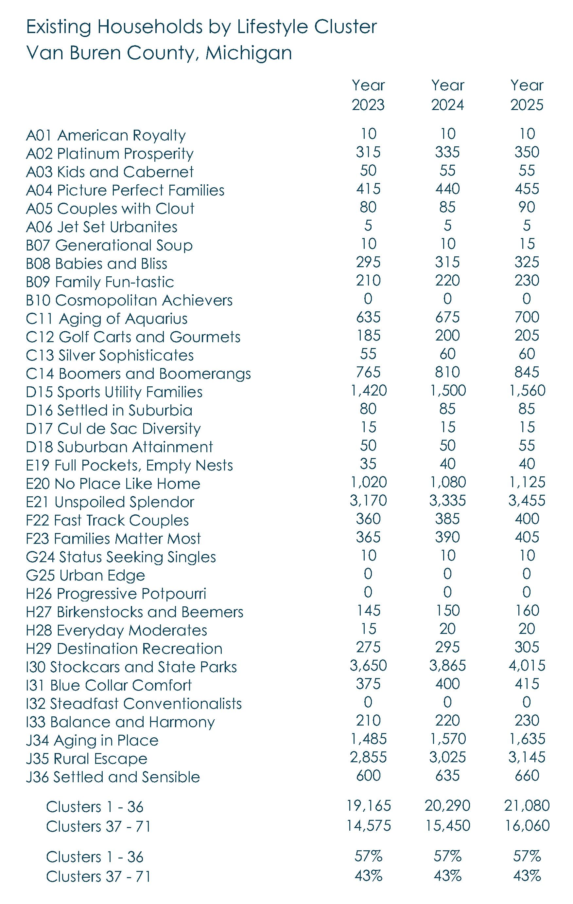
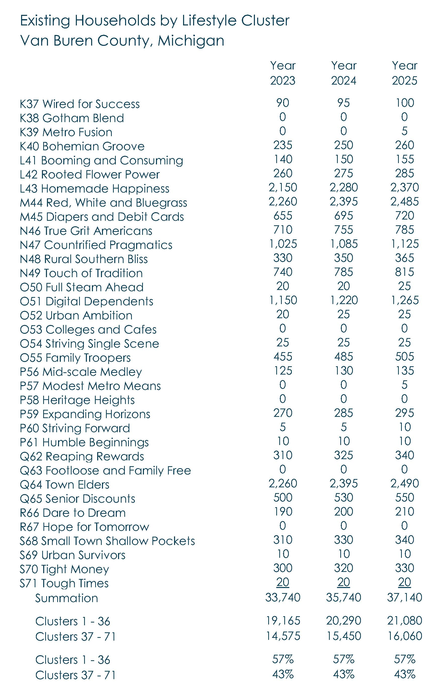
Van Buren Co | 71 Existing Lifestyle Clusters
Tables also are provided for additional reference, and include estimates for the year 2024 and forecasts for the year 2025. The forecasts in particular are essential inputs into the housing analysis and gap model.
The histograms and tables also include summaries for each half of the lifestyle clusters. For example, about 57% of the county’s existing households fit into the first half of the mosaic, and 43% in the second half. These are intended to provide an additional point of reference when comparing the townships, cities, and villages.
Sec
3-B

Slide 37


Paw Paw vs. Mattawan | Comparison
All exhibits in the market analysis can and should be compared between geographies to identify commonalities and differences. For example, the Village of Paw Paw has twice the number of households as Mattawan. Even so, Mattawan has twice as many existing households in the Families Matter Most lifestyle Cluster (90 vs. 45 households). Mattawan also is doing a better job at attracting Fast Track Couples (25 vs. 10 households).
Also, Mattawan’s existing households have a more affluent profile compared to Paw Paw. In Mattawan, 63% of the existing households are among the first half (and more affluent half) of the lifestyle clusters, which is higher than Paw Paw (54%).
Sec
3-B

Slide 38


United States | Experian Decision Analytics
Experian’s 71 lifestyle clusters can be scattered on an x-y axis based on family composition, income, and head-of-householder’s age. The results are similar to a “Mosaic” (Experian terminology), “Tapestry” (ESRI), or “Prizm” (Nielsen).
Experian provides 20 pages of data for each unique lifestyle cluster. This includes many variables relevant to the housing industry, such as urbanicity (inclination to live in a city versus a rural place); tenure (owners and renters); movership rate (share that moves in any given year) by tenure; inclination to choose detached versus attached units (i.e., houses, cottages, duplexes, and townhouses versus condos, lofts, and apartments); and price tolerance (values and rents).
All of these variables are fundamental to the underlying methodology used to complete this Target Market Analysis for Van Buren County. Also, Experian’s average incomes and prices by lifestyle cluster for the United States have been adjusted for Van Buren County and for each of its townships, cities, and villages.
Sec
3-J

Slide 39


Van Buren Co | Existing Lifestyle Clusters
Experian’s methodology relies partly on consumer credit and debt data, which is garnered from credit cards, magazine subscriptions, and more. It also is reflects property characteristics garnered from geocoding, IRS reports on tax returns, and household mortgages and leases. Finally, it also reflects demographic and socio-economic data garnered from the United Stated Census, including the American Community Survey.
Sec
3-J

Slide 40


Van Buren County | Demographic Parameters

Slide 41
Van Buren County | Acknowledgements
Van Buren County Administration
Lisa Ransler, Community Services Director
Van Buren County Administration
219 E Paw Paw Street, Ste 302
Paw Paw, MI 49079
phone | 269-657-8200 x1073
email | ranslerl@vanburencountymi.gov
Market One Van Buren and Cass Counties
Economic & Community Development
Zachary Morris, Executive Director
32849 Red Arrow Hwy, Ste 100
Paw Paw, MI 49079
phone | (269) 519-6142
email | Morrisz@marketvanburen.org
Consultant
LandUseUSA | Urban Strategies
Sharon M. Woods, CNUa
President
Phone | (517) 290-5531
email | sharonwoods@landuseusa.com

Slide 42

Van Buren Co | Travel Time to Work
The Demographic Analysis for Van Buren County focuses specifically on demand and supply variables that are most relevant to the housing industry. All of the data has been provided by the United States Census, American Community Survey, and DemographicsNow (a data vendor similar to ESRI or Nielsen).
The following slides highlight results for Van Buren County with comparisons to the adjacent Allegan, Kalamazoo, Cass, and Berrien counties. Similar demographic data is provided in the study for each township, city, and village in Van Buren County. Interested readers are encouraged to make comparisons between those local places.
To begin, 33% of Van Buren County’s commuters travel thirty (30) minutes or more, which is similar to Allegan and Cass counties, but higher than Kalamazoo and Berrien counties. Throughout the region, no more than 12% commute more than 45 minutes, and no more than 5% commute more than 60 minutes to work.
These results suggest that new workers at a reopened Palisades Power Center would generally prefer to live less than 45 minutes from their place of employment. This information has been used to estimate the magnitude of growth under the aggressive or growth scenario, and compared to the conservative or status quo scenario.
Sec
2-D

Slide 43

Van Buren Co | Renter-Occupied Households
Van Buren County currently has about currently has over 7,600 renter households, representing about 22% of all households in the county. This is a little higher than Allegan and Cass counties (18% and 19%, respectively), but significantly lower than Kalamazoo (37%) and Berrien (28%) counties.
The results for Van Buren County suggest an upside market potential for new residential units for the renter market. There is some element of truth to the adage “build it and they will come.” However, cities and villages in the county are cautioned against over-building conventional apartment buildings for the renter market, and instead should explore other Missing Middle Housing formats like cottages, accessory dwellings, townhouses, and lofts over street-front retail.
Sec
2-D

Slide 44

Van Buren Co | Owner and Total Households
Van Buren County currently has about 27,500 owner households, representing about 78% of all households in the county. For perspective, owner households represent about 82% and 81% of the total in Allegan and Cass counties, respectively. However, owner shares are significantly lower in Kalamazoo and Berrien counties (63% and 72%, respectively) .
Based on the Target Market Analysis (TMA), Van Buren County can support the development of at least 730 new-build for lease residential units annually, and over the next five years. However, there also is an opportunity to build at least 600 new for sale units. Therefore, the addition of new rental units would barely tip the scale in the overall share of renters. By 2030, renter households are unlikely to surpass 20% of all households.
Sec
2-D

Slide 45

Van Buren Co | Household Income by Tenure
Van Buren County’s median household income currently is about $80,000. However, its home owners have a higher income of about $90,000, and its renters have a significantly lower income of about income of about $45,000.
Van Buren County’s median household income for owners is $90,000, or similar to Cass and Berrien counties ($89,000 for each). However, it is lower than Allegan County ($97,000) and Kalamazoo County ($105,000).
In comparison, Van Buren County’s median household income for renters is only $46,000, which is similar to Allegan ($45,000), Cass ($47,000), and Berrien ($45,000) counties; and a little lower than Kalamazoo County ($50,000).
Differentiating incomes by tenure is an essential step in the analysis. In general, the rule-of-thumb is that renters should spend no more than 30% of their income on contract (cash or net) rent; and owners should spend no more than 40% of their income on a mortgage to be in “affordable” housing. However, actual price tolerances could be higher, and as much as 45% for renters and 60% for owners.
Sec
2-D

Slide 46

Van Buren Co | Movership Rates by Tenure
Although renters represent a smaller share of total households in Van Buren County (less than 20%), renters have significantly higher movership rates. Note: A movership rate is the share of households that moves in any given year.
On average, about 5.4% of all existing owners moved within Van Buren County in the past year (i.e., internal movership); and about 4.8% of all existing owners migrated into the township from beyond (i.e., in-migration).
In comparison, 13.1% of Van Buren County’s existing renters moved within that same township, and 8.4% of its renters migrated into that market in the past year.
The blended movership rate among new owner and renter households migrating into Van Buren County is 4.8%, which is a little higher than Allegan and Kalamazoo counties (4.6% and 4.3%, respectively), but lower than Cass (8.2%) and Berrien (5.3%) counties.
These differences in movership rates by tenure and geography have a significant influence on the market potential and Target Market Analysis results for both the conservative and aggressive scenarios.
Sec
2-D

Slide 47

Van Buren Co | Detached vs. Attached Units
The prior slides on demographics focused on demand, measured based on households and income by tenure, and movership rates. This and subsequent slides focus on supply, measured based on housing units, vacancies, and prices (values and rents).
To begin, nearly all (over 98%) of existing owner-occupied housing units in Van Buren County are detached houses with private entrances; and very few (less than 2%) are among attached formats (with private or shared entrances).
In comparison, nearly 60% of existing renter-occupied housing units in Van Buren county are among detached houses (including some subdivided houses); and over 40% are attached formats with shared entrances (such as apartment buildings).
For comparison, renter households in Kalamazoo County are far more likely to be residing in attached building formats with shared entrances.
Sec
2-D

Slide 48

Van Buren Co | Reasons for Housing Vacancies (#)
Van Buren County currently has almost 5,000 residential vacancies that are attributed to seasonal or occasional uses. In addition, it has over 400 vacancies available for rent (or rented but not yet occupied); and about 300 vacancies available for sale (or sold but not yet occupied).
These numbers do not include existing units that are currently occupied and nevertheless available either for rent or sale. They simply provide some insight into the reasons for the county’s existing vacancies.
Sec
2-D

Slide 49

Van Buren Co | Reasons for Housing Vacancies (%)
Over 13% of Van Buren County’s current vacancies can be attributed to units that are for seasonal or occasional use. Seasonal units aside, Van Buren County’s adjusted vacancy rate is about seven percent (7%). In general, the adjusted vacancy rates for the comparison counties range between five and seven percent (5% to 7%).
Most communities tend to aspire for a vacancy rate of eight percent or lower (<8%); and vacancy rate of six percent or lower (<6%) could exacerbate a housing shortage.
On the other hand, a high vacancy rate does not necessarily mean that there is no housing shortage. Rather, it could indicate that the housing supply is outdated or obsolete. In other words, it might not be meeting the wants, needs, or expectations of migrating households.
Sec
2-D

Slide 50

Van Buren Co | Prices – Values and Rents
Van Buren County’s median home value is about $225,000, which is lower than the other four comparison counties. The median home values are highest in Allegan County ($335,000).
In general, buying a home in Van Buren County could be a relatively “affordable” alternative to higher prices in other parts of southwest Michigan. However, more expensive homes also are more likely to be newer and larger than relatively “affordable” alternatives.
Van Buren County’s median contract (cash or net) rent currently is less than $800 per month, which is low compared to the other four comparison counties. Note: These rents exclude short-term rentals. The suppressed rents hint at the absence of choices among new-build units that typically would command higher prices.
Median gross rents typically include utilities and other unadvertised fees for parking, clubhouse memberships, pets, delivery services, and cleaning deposits. In Van Buren County, these extra expenses can easily add more than +$250 per month to the overall cost of housing.
Sec
2-D

